Slide 1
BYNDER TRAINING #2​
Notes:
Good afternoon everyone!
The aim of todays training session is to improve your knowledge of the Bynder platform and introduce you to the workflow and guidelines modules.

Slide 2
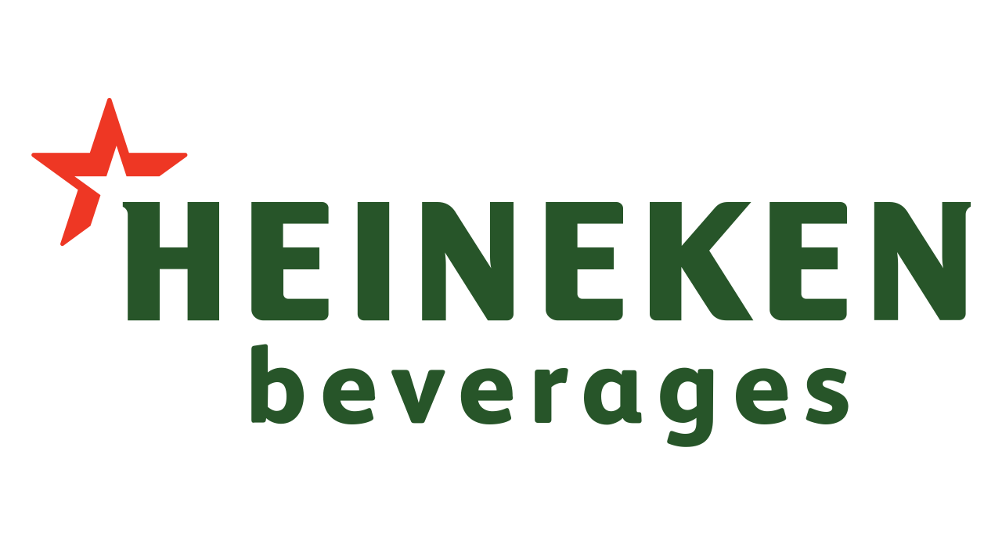
What we will cover in this session
Brief recap of the Bynder purpose and capabilities​
Workflow & Guidelines modules within Bynder​
Responsibilities within these modules
Workflow module demonstration
Notes:
Those of you who attended the Bynder training last week will be familiar with the format and direction of todays training. However, the approach is different as we will be looking at two new modules within the platform.
Today’s training specifically concerns the Workflow & Guidelines modules within Bynder. We will be looking at:
What these modules are
The roles and responsibilities of the stakeholders on this call, and how this plays into these new modules
And we will be doing a full demo of the workflow functionality
We will begin by ensuring alignment on the process and function of Bynder, by recapping its purpose and then diving deeper into the modules.

Slide 3
Bynder Recap​
PURPOSE
To serve as the single source of truth for all marketing related assets
To serve as a shared digital library to ease collaboration between all parties involved in achieving the organisations objectives.
To house, and protect our owned assets – assets should not be stored on agency servers.
Notes:
Lets begin with a recap:
Bynder’s role within the organisation is crucial as it serves as the single source of truth in the entire workflow chain from campaign ideation, to execution and sales.
- It serve as the internal system for all Heineken owned assets. Assets should not be on agency servers.
- There are several key stakeholders working to achieve the organisations mission and Bynder serves as the facilitation and collaboration tool between all parties, across the organization.

Slide 4
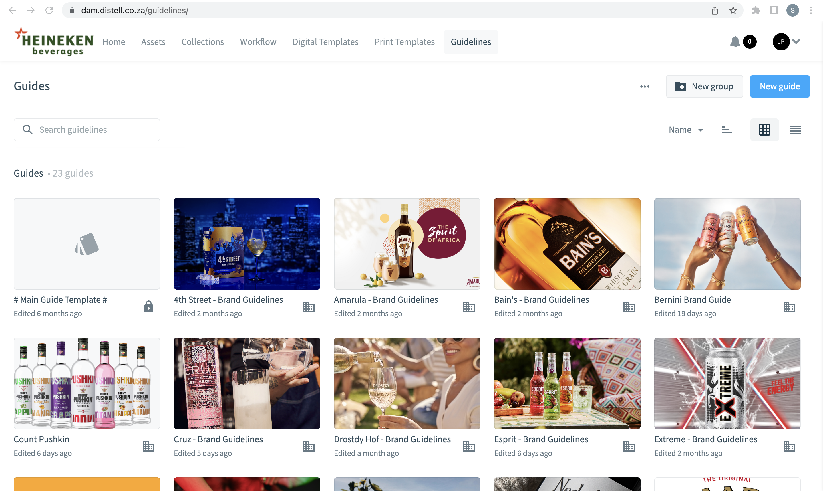
Brand Guidelines​
Single Source for sharing all crucial brand information.
Notes:
The brand guidelines module serves as the location for all brand guidelines documents.
These guidelines can be used when briefing agencies, to share with clients, and many other cases.
These guidelines are a consolidated presentation of core brand assets, characteristics, and regulations.
There are 2 very important things to note within this module:
Where to find the assets housed within the document - The assets that are within the reference document, can be found in the assets module of Bynder, under the brand guidelines filter.
How accurate are these documents? - Brand teams are responsible for keeping these up to date – so if you have updated anything concerning your brand, you must ensure that your brand guidelines document is updated along with all other assets. – This is how you do that…

Slide 5
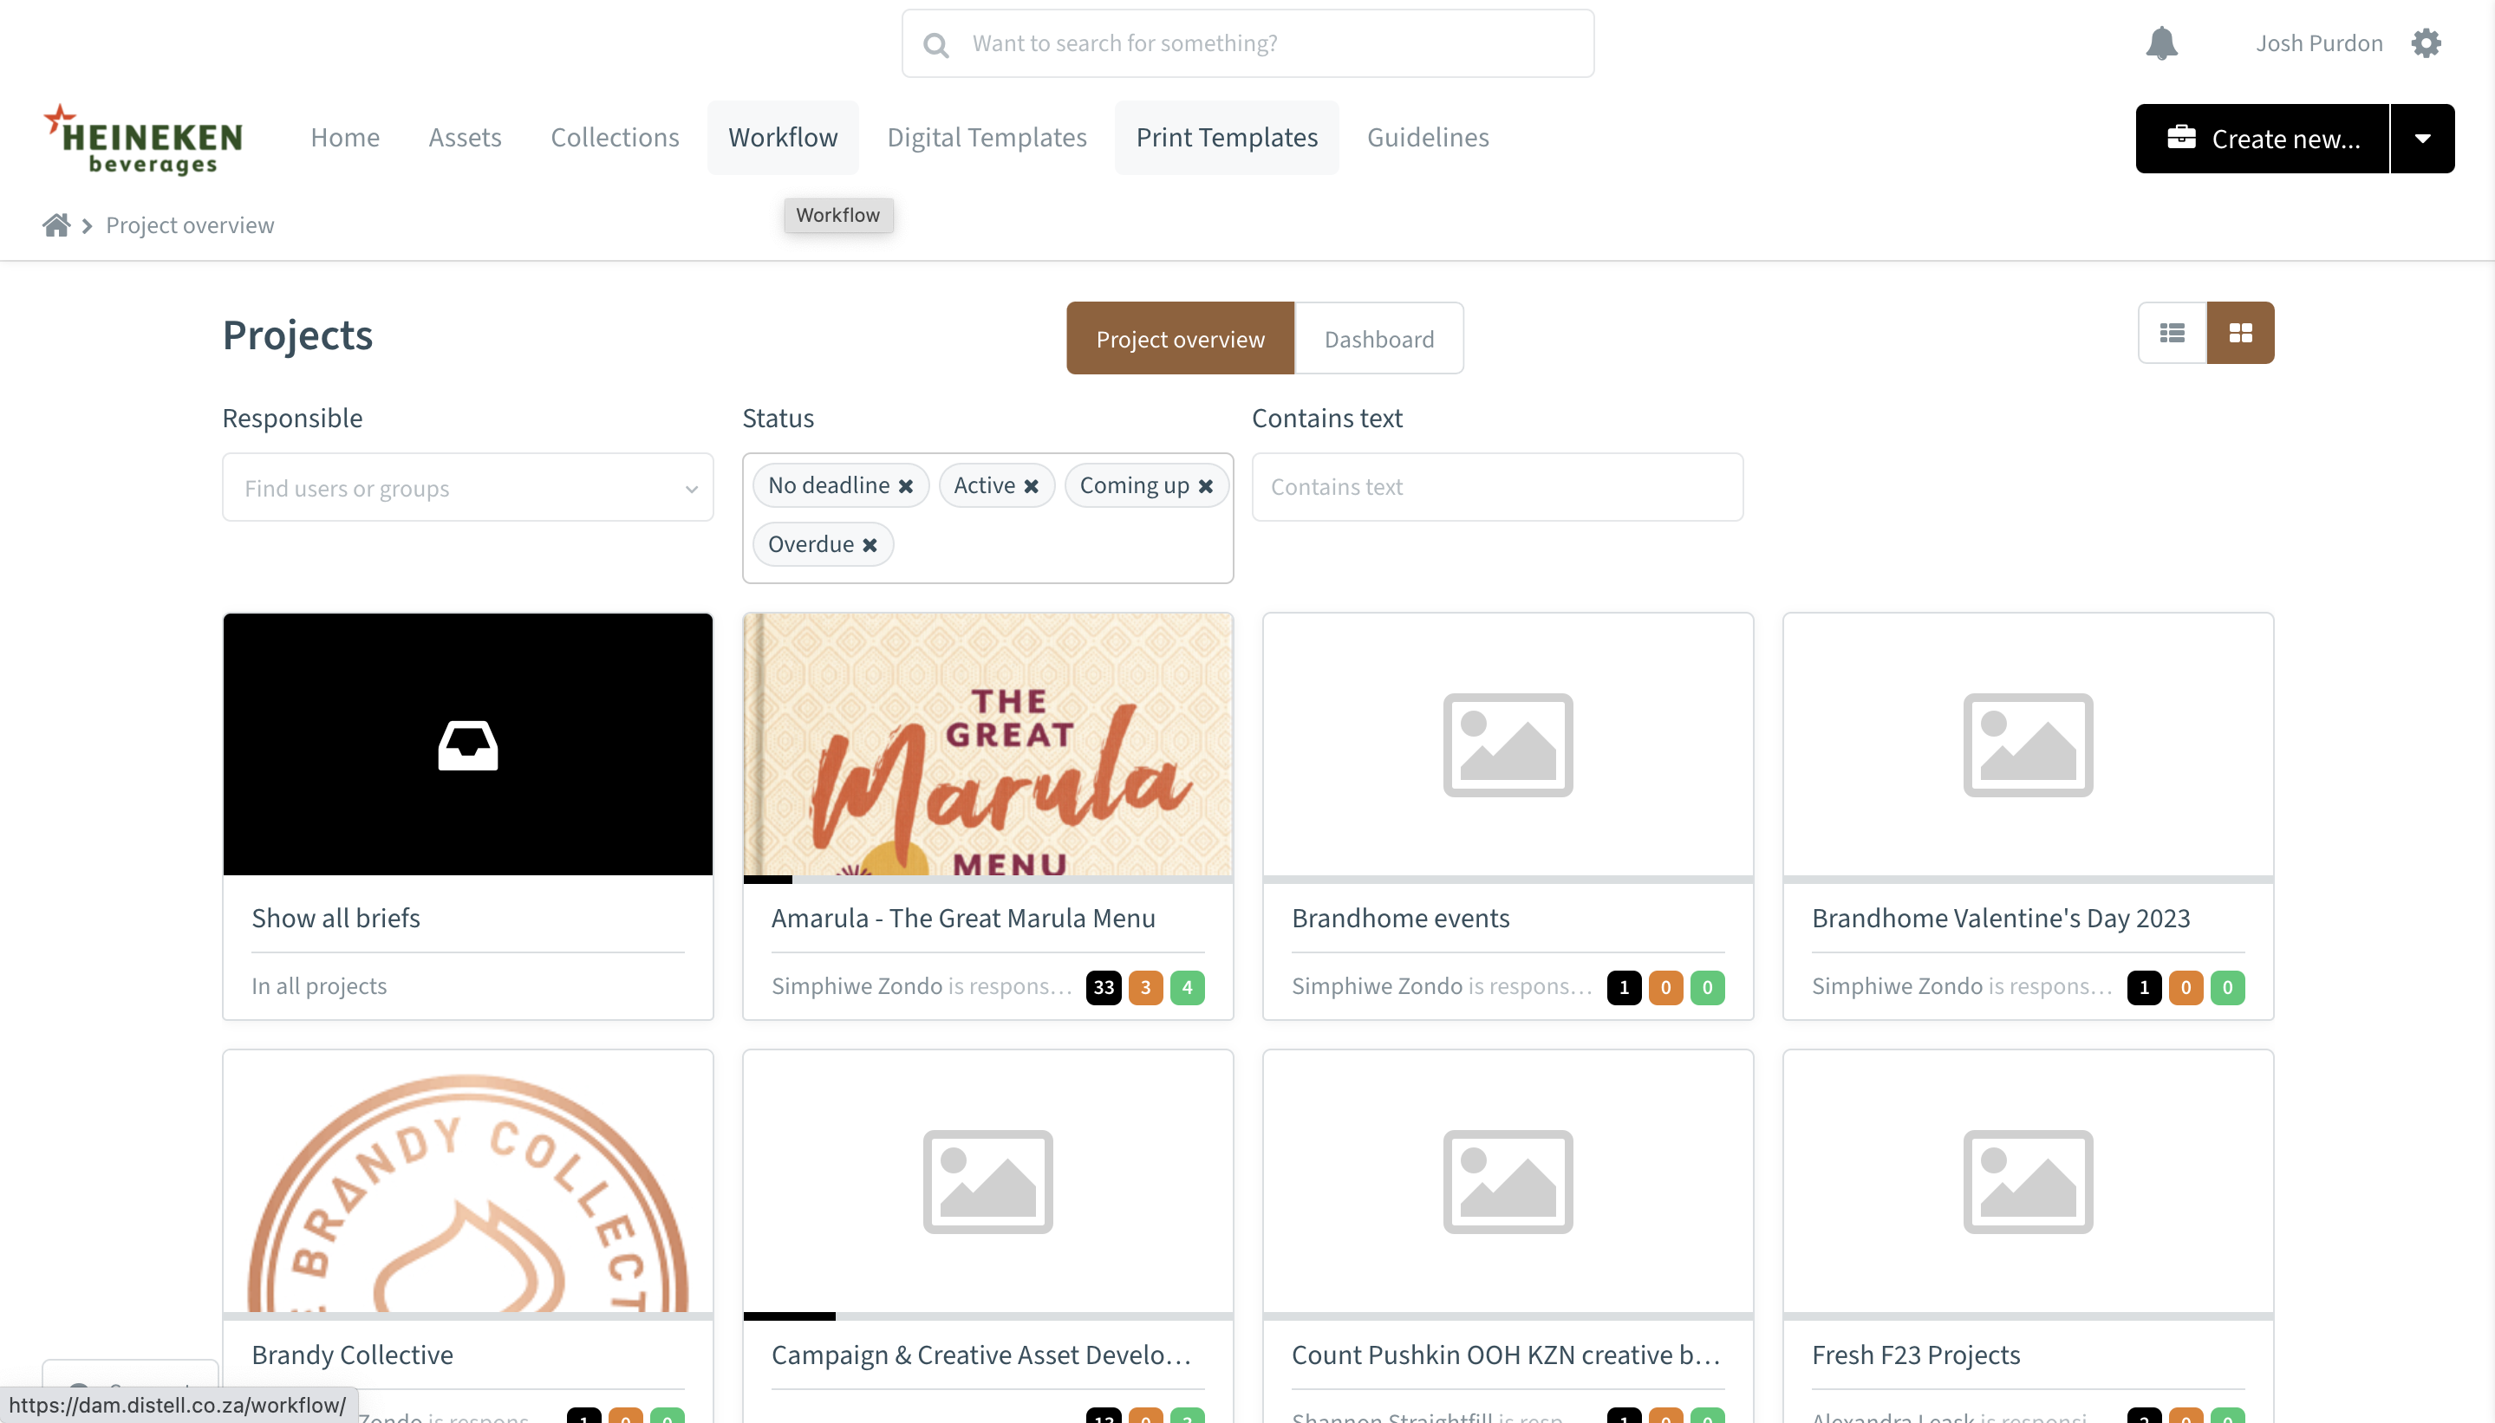
The Workflow Module
Speed​
Accuracy/reliability​​
Transparency
Notes:
The workflow module is the most powerful module within Bynder.
It can facilitate any variation of the asset development process, and is easily adaptable to suit any custom steps, instructions or tasks. This adaptability allows for speed to market, accuracy of execution, and transparency throughout the entire process.

Slide 6
How does this benefit me?
Speed​
Accuracy/reliability​​
Transparency
Collaboration
Single Source
Alignment
Control
Notes:
Now you may be asking: ”How?”, how does this benefit me or how does this work? – The workflow module serves to address 3 key pain points that marketers face using the traditional asset development process. These are:
1. Slow turnaround times:
The Bynder workflow module provides the same features and functions of email, teams, and WhatsApp – but in one single location/platform.
Second: Inaccuracy/lack of control
Bynder workflows allow users involved to complete all tasks that are part of the current way of working. While also:
Offering strict control processes, that prevent the project from moving forward without the appropriate approval. - Approvals can be set up at any point during this flow, for any type of approval and assigned to the necessary individual/team. Ie, legal team approval, media team, etc.
Furthermore, this module facilitates a very collaborative environment, with assignment controls.
The third pain point that this module addresses is: Lack of Transparency & Alignment
Bynder workflows allow users to go back and forth between steps, so it is not necessarily a strict linear function. However, approvals are required to move forward.
This ensures consistent alignment on the tasks at hand.
This also allows users to view the history of the project, such as past comments, reverts etc. – ensuring transparency for all.
For example: as a member of the creative development team within your given agency, you may only be involved in step 3 of the asset development process, but you will have a view on all work and discussions that have been completed beforehand.

Slide 7
Workflows
Create a ‘project’ (campaign)
Create a brief
Complete the workflow
Upload final asset(s) to Bynder
Notes:
The process of creating and completing a workflow, happens in 4 steps.
However, before we delve into the details and how to of each step – I would like to note that any assets, reverts, etc. completed within this process – are not housed within Bynder, and will not need to go through the upload auditing process. The assets are merely hosted within this specific module and so, only the final, approved for market assets will be stored and uploaded to your brand environment on Bynder.
Just because you’ve been loading assets for review, within workflow – this does not mean your assets will be stored within the assets module on Bynder. Once brand team approval has been granted, you will then still complete the traditional file upload process (so that your upload may be audited against the taxonomy and naming convention guidelines of Bynder).

Slide 8
1. Create project
Project Name
Responsibility
Timeline
Create
Logo_Horizontal-01.jpg
2. Create brief
Use the brief option titled: ​
brief (current brief to use)
Assign to project
Job name
Description
Notes:
Creating what Bynder calls a ‘project’ – it houses all sub-campaigns and briefs within it.
The responsibility of this task generally falls on the brand team (however, this will depend on the specific case and what team is giving the instruction).
The creator of the project will have oversight over all briefs, and campaigns within it, and the ability to control the flow within each brief – as such, it is imperative that the creator is the appropriate individual responsible. For example - if you set up a project for the brand Savanna, and call the project: Savanna Easter Campaign – the brand manager, or category lead could be the one responsible.
This is how to create a project…
Creating a brief
There will be several briefing options to choose from, depending on the specific case – for example: creating a print template, or a TVC brief.
However, for now (until these workflows have been designed, approved, and implemented into the platform) you will use the generic structure, labelled as: brief (current brief to use).
A brief is where the brand team will input the briefing details into a pre-determined template, and initiate the workflow process. In this case: the responsible party could be lower in the hierarchy, such as an assistant brand manager.
This is how to create a brief…

Slide 9
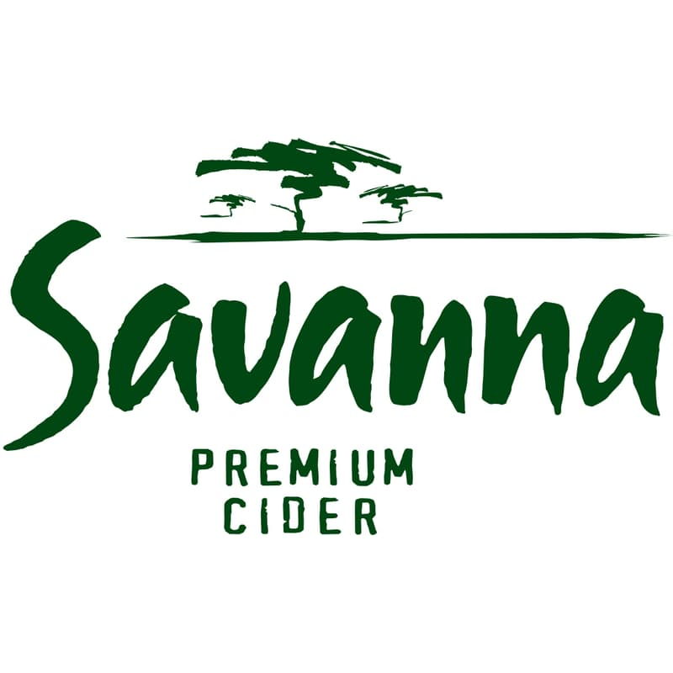
3. Complete workflow
Brief
Timing Plan
Creative Reverts
Final Feedback
Savanna Premium Cider Logo (To Be Used on White Backgroun
4. Upload assets to Bynder
Savanna Logo White Background 2023
Brand Name
Date
Asset Type
Descriptor
NB: File title on PC
*No Symbols
Notes:
Completing the workflow
This is the process of everything that happens between the brief being submitted to agency, and the final assets(s) being approved for use in the market.
During this process, agencies and various other parties get involved.
There will be various iteration of this process, depending on the specific case and brief selected. But once again, for now – please use the generic flow, which concerns 4 main aspects (as shown in the slide).
Upload the final asset(s) to Bynder
Once the asset(s) have been approved for use in the market – The next step is to upload the asset to the actual asset bank within Bynder.
This is simply completing the standard upload process at the end of the workflow, whereby a system admin will audit the asset for correct Naming conventions, and taxonomy.
Once this step is complete - your final assets will now be stored on Bynder for you to access and use. (NB – just because creative approval has been received, does not mean it will be in the asset bank).
Remember to apply the correct naming conventions to avoid any delays. – the best way to ensure this would be to use these naming conventions for files on your PC before uploading anything to Bynder.
We will now give run through a demo of all the features and systems within step 3: the completion of the workflow.

Slide 10
QUESTIONS
Support: joshua.purdon@heineken.com
Notes:
Key things to note on Workflow:
Tasks and assignments
Comments/messaging section
Left panel that shows the briefing information constantly
Comparison feature between various reverts
Finally, are there any questions?
The recordings of each session will be shared at the end of the sessions.
Please reach out to me if you require any support or assistance at any time: email on screen

Slide 11
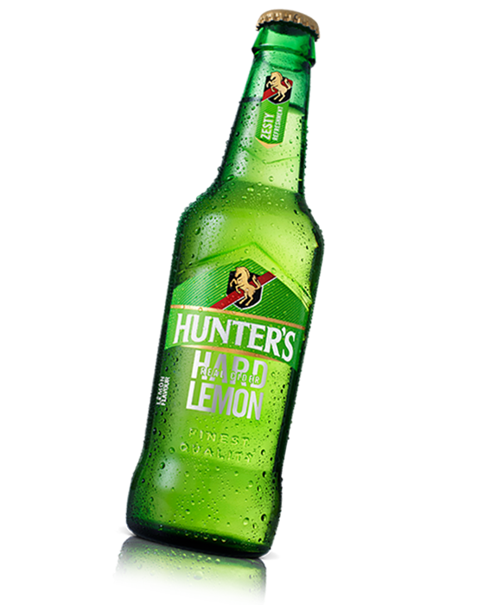
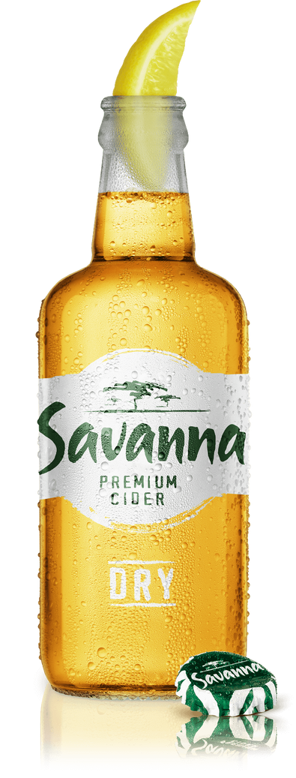
THANK YOU

