Slide 2
Module 3: Get started with…
Notes:
You will recall in our overview of Bynder, we shared an understanding of digital templates.
We invited you to think about those digital touchpoints that you use a lot, we mentioned:
Social posts that lend themselves to templates ie: Winner announcements, Listing announcements.
Web/ advertising banners
Fact sheets

Slide 3
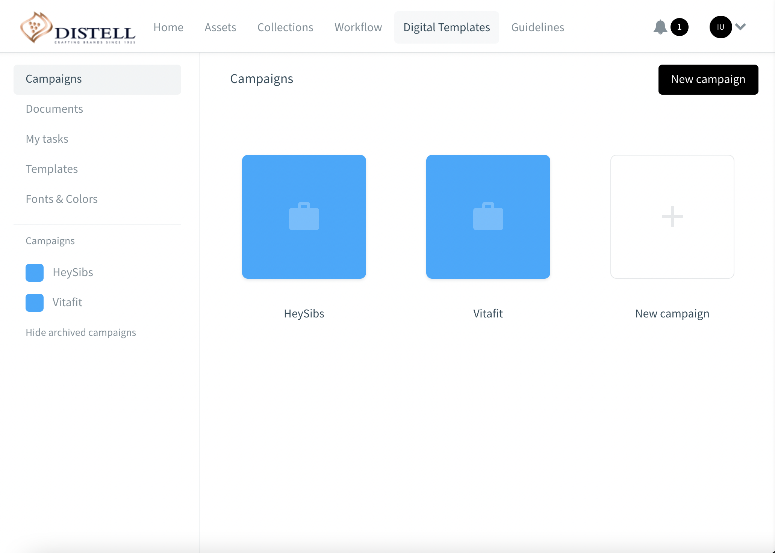
Introduction
In this module we will cover:
1
How to set up templates for end users (BRAND TEAM and CREATIVE TEAMS)
Brands
2
How to Adapt a Digital Brand Template (TRADE MARKETING, IN MARKET AGENCIES & DISTRIBUTORS
3
Approve an adapted template (BRAND TEAM)
Notes:
Digital brand templates enable brand owners to control brand look & feel and consistency of use of brand assets.
If you set these up correctly, you can rest assured that your in-market colleagues and partners have a bank of content at their disposal for adaptation.
Templates will consist of ‘fixed’ and ‘editable’ sections. For example:
The layout could be fixed, but you could update the copy: think, local language translation.
The layout could be fixed, but you could update the packshot: for those countries that use different packs.
You could fix standard items like your logo and packshot, but enable a different background image.
There are many different applications of this feature and we have no doubt it will save on time, costs and create agility in our market execution practices.
In this module we’re going to show you how to SET UP TEMPLATES FOR END USERS
How adaptation works OF TEMPLATES WORKS.
How to approve a digital brand template.

Slide 4
Setting up digital templates for end user use.
Notes:
Let's start with how to set up a digital brand template.
This will typically done by creative teams, as briefed by brand teams.
Take a look at how we’ve structured our templates.

Slide 5
Before we start, make sure you have the right access
“Create documents”
Users with
this permission need approval to create
Notes:
You’ve all been working in Bynder for the last two weeks.
Hopefully if you needed to change your permissions and access profiles or update the brands that you’re linked to – that’s been done already.
This is important because it determines your permissions/ access to this feature.

Slide 6
Reviewing the menu
1
This is the menu available to you if you are going to adapt existing templates and publish
1
This is the menu available to you if you are going to create a bank of templates for end users to adapt and publish​
Notes:
Productive users will typically be creating templates for end market use.
So that’s brand teams, trade marketing teams and agency partners.
Bear in mind, as an end market/ in market user (consumptive user) of brand digital templates, you can also make recommendations to your brand/ trade marketing team partners on the types of templates you need.

Slide 7
Creating a bank of digital templates
Notes:
Now we’ll consider the way users can use existing documents and adapt them for their own use.
Bearing in mind your permissions, you may need to send your adapted template for approval before you can publish it as an asset.

Slide 8
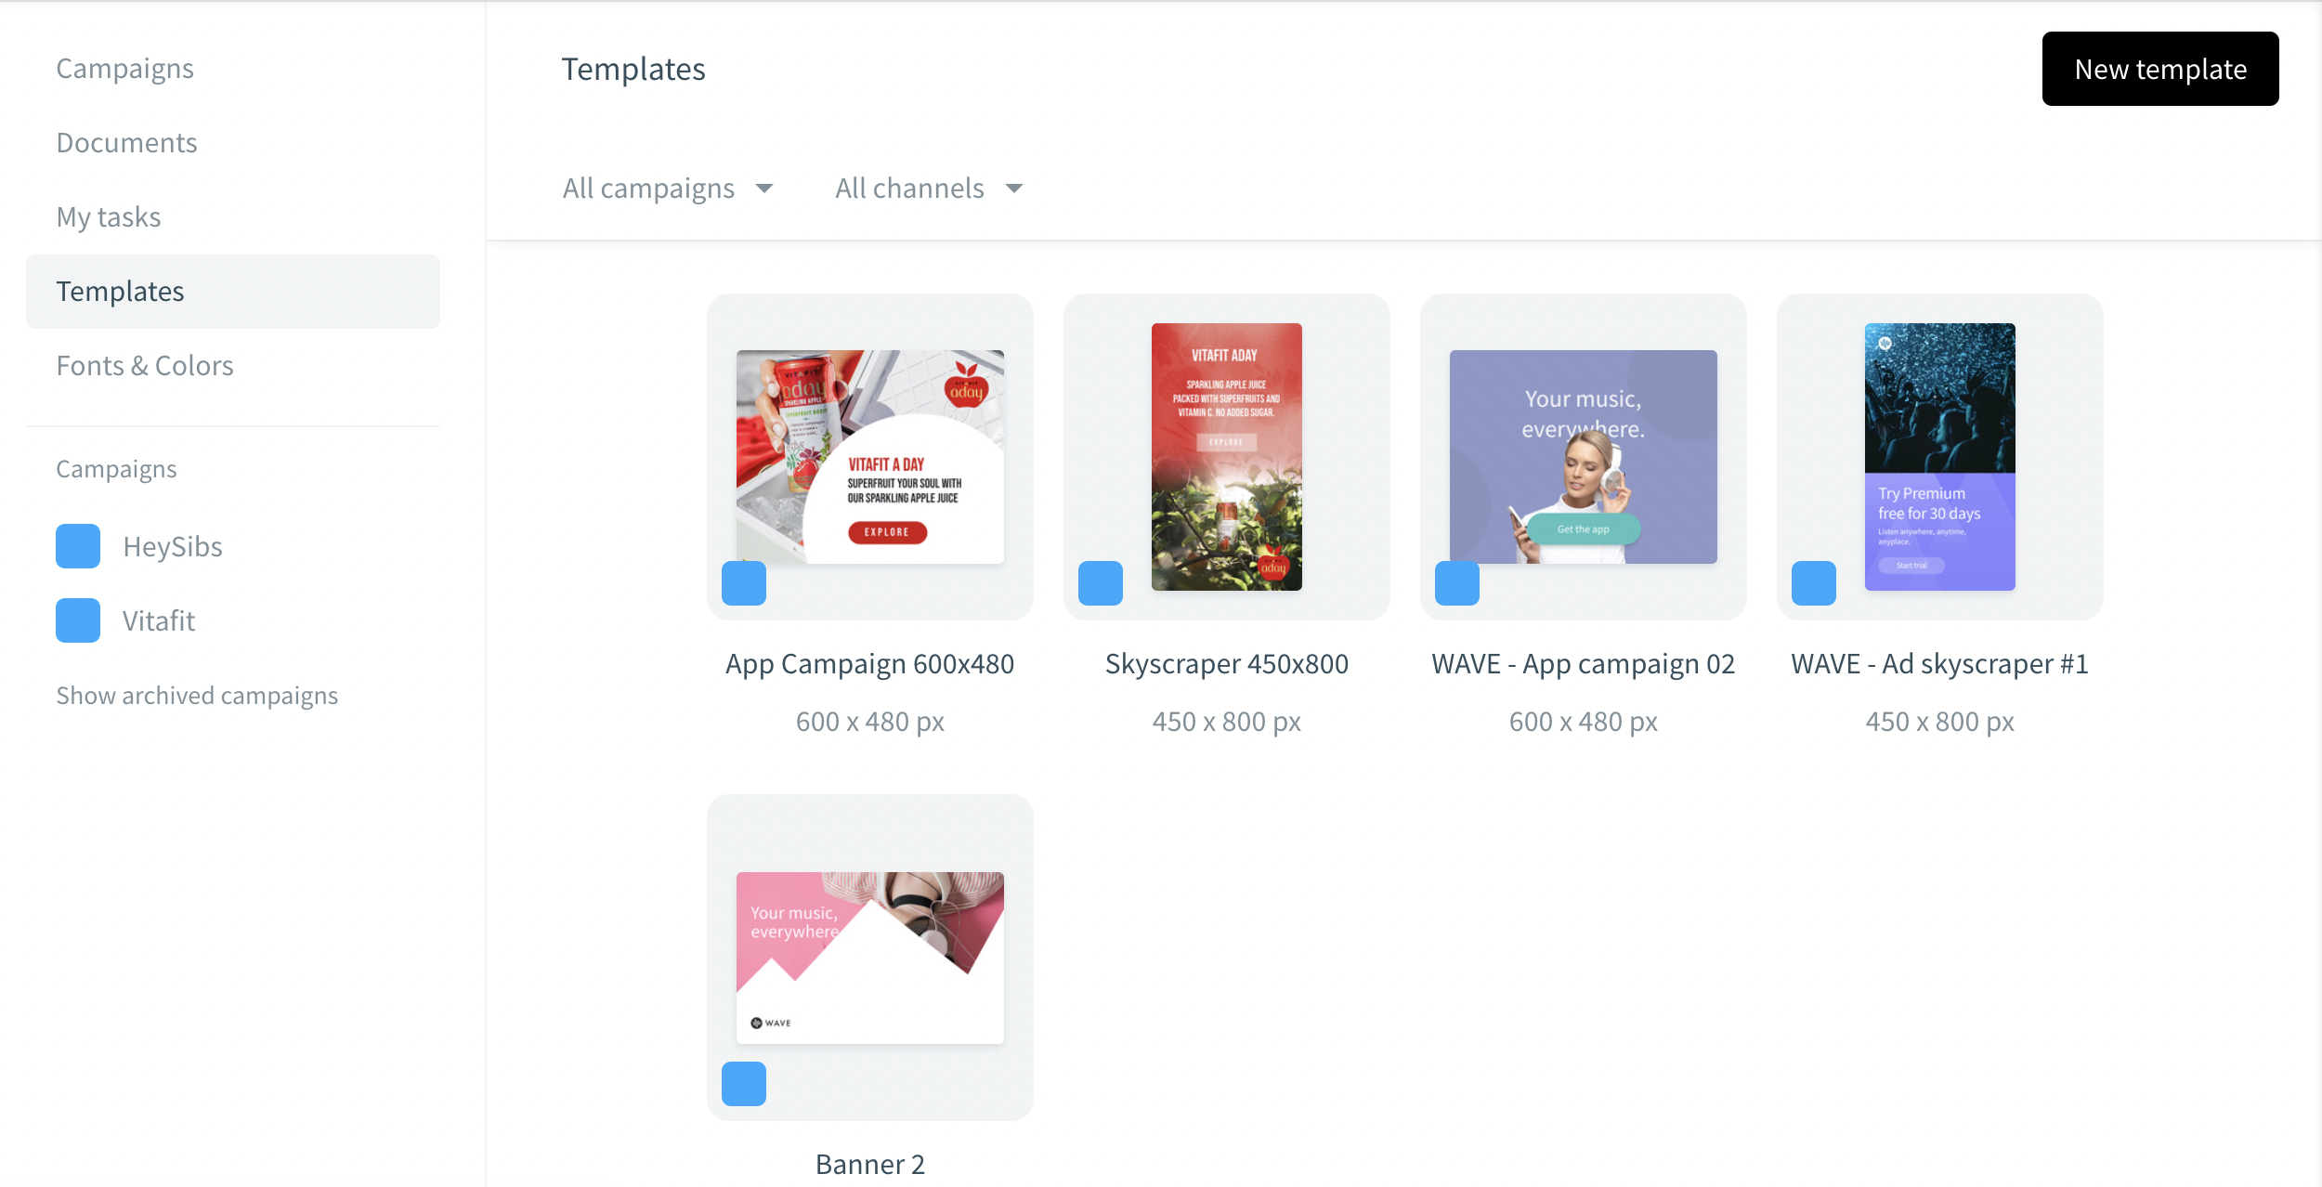
Creating a Digital Template
Adaptation takes place here
Level 5 Users can create templates
Notes:
First, lets get oriented on the menu.
Adaptation takes place in Documents.
Templates – is where the creative team loads the psd or indesign files and locks/ makes sections adaptable.

Slide 9
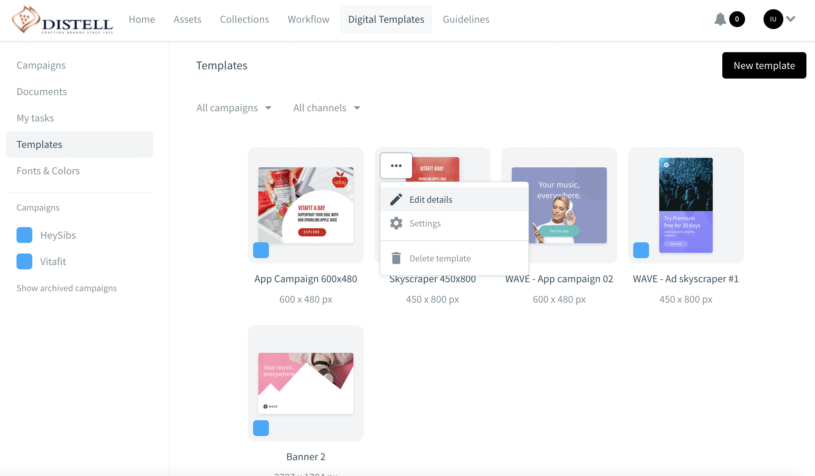
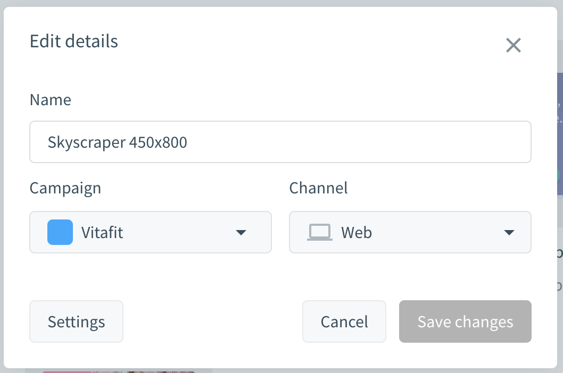
Creating a Digital Template
Manage template permissions here
Apply relevant taxonomy
Notes:
When creating a template, remember to apply the relevant taxonomy and permissions.

Slide 10
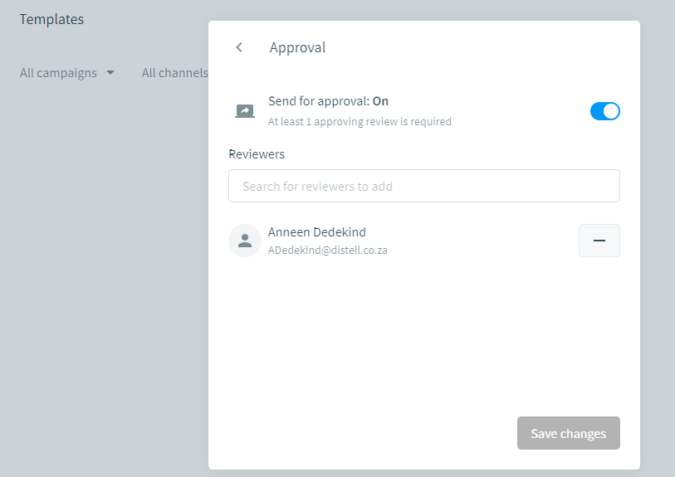
Managing approvals for a Digital Template
Edit details
>Settings
>Send for approval
>Approver
Notes:
If you don’t assign an approver – the adapted template will be ready for download. (no control)

Slide 11
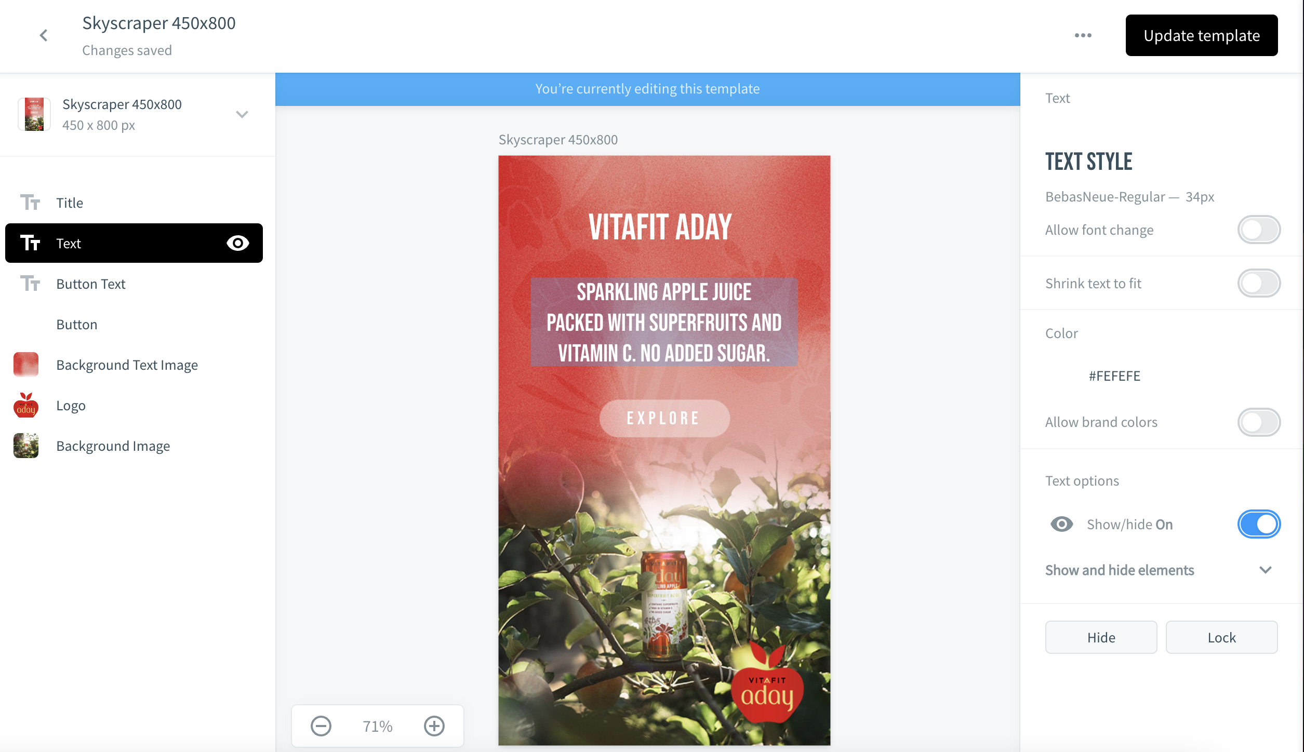
Use the Digital Template Editor
Within templates
Linked layers are indicated by the icon in the left sidebar. Also, when you click a layer the ’Linking’ status in the right sidebar will tell you whether linking is ’On’ or ’Off’.
Layers can be hidden or shown. Visible layers are indicated by the icon
Layers that are hidden are indicated by the icon.
1
2
3
Notes:
Working with the sections in the left hand menu you can determine what to lock and what can be adapted.

Slide 12
Adapting a digital brand templates
Notes:
Now we’ll consider the way users can use existing documents and adapt them for their own use.
Bearing in mind your permissions, you may need to send your adapted template for approval before you can publish it as an asset.

Slide 13
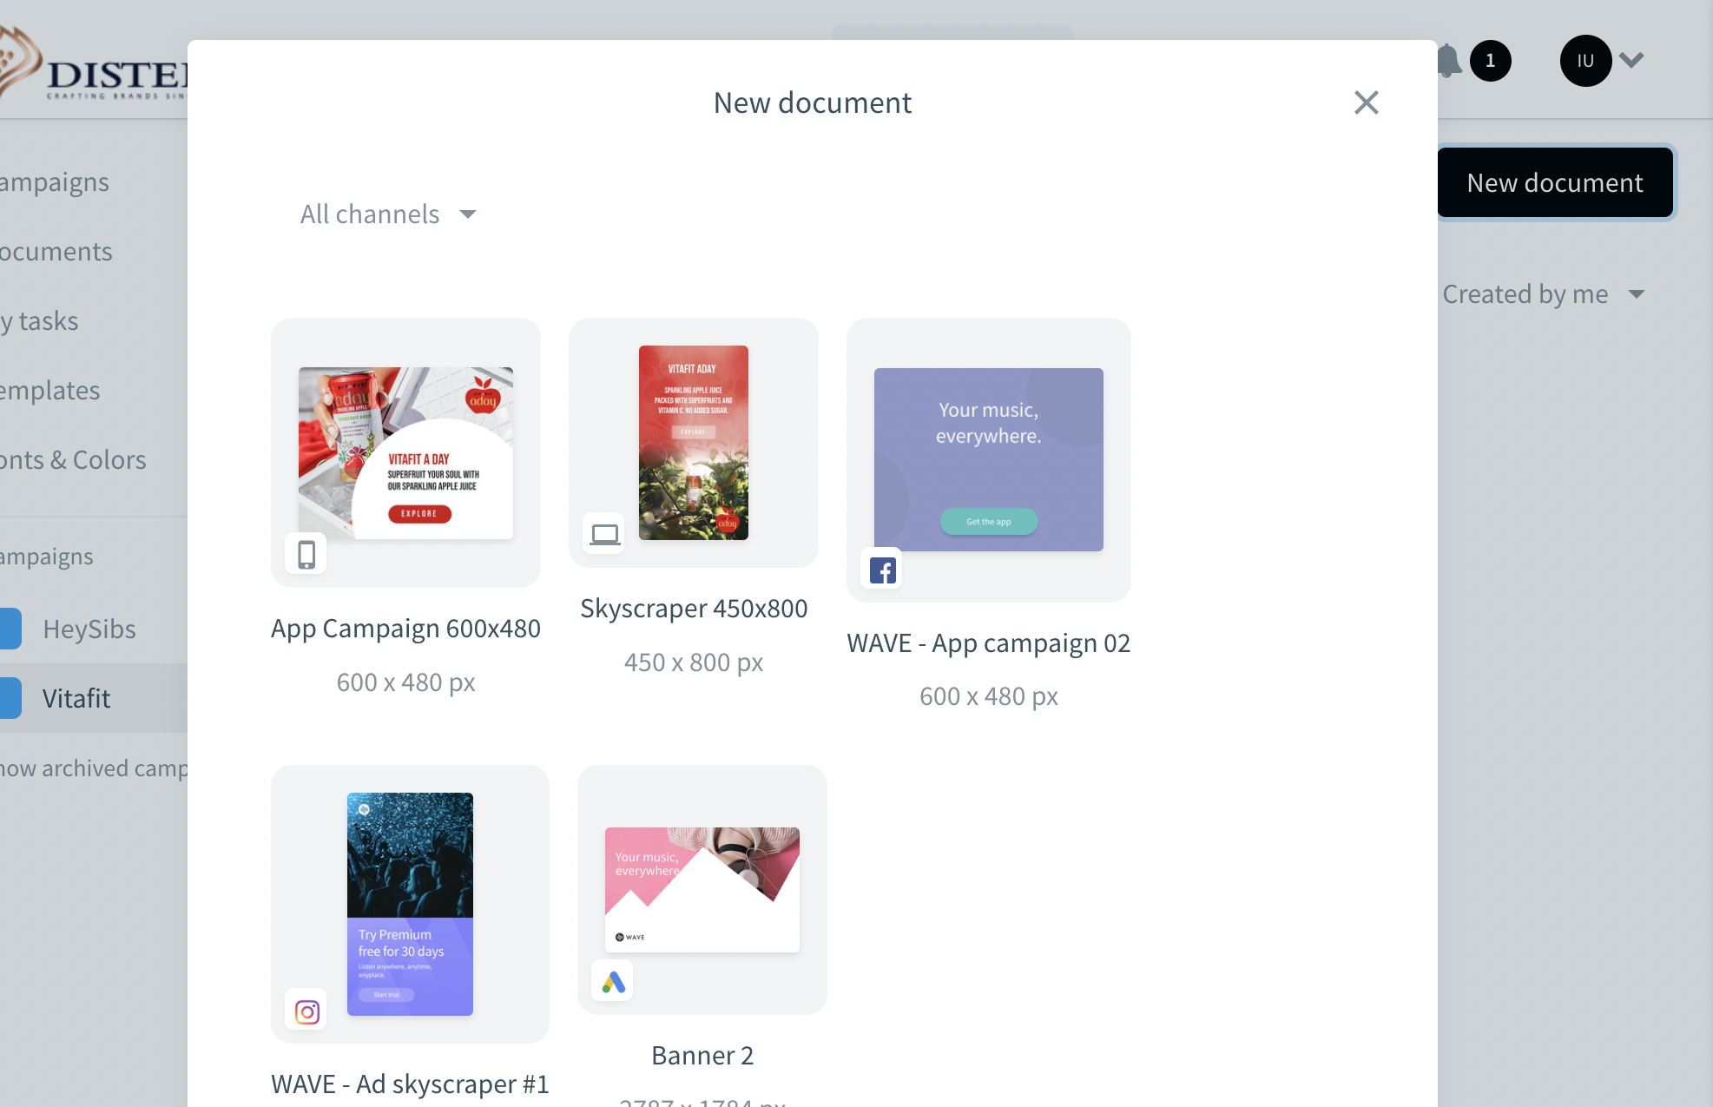
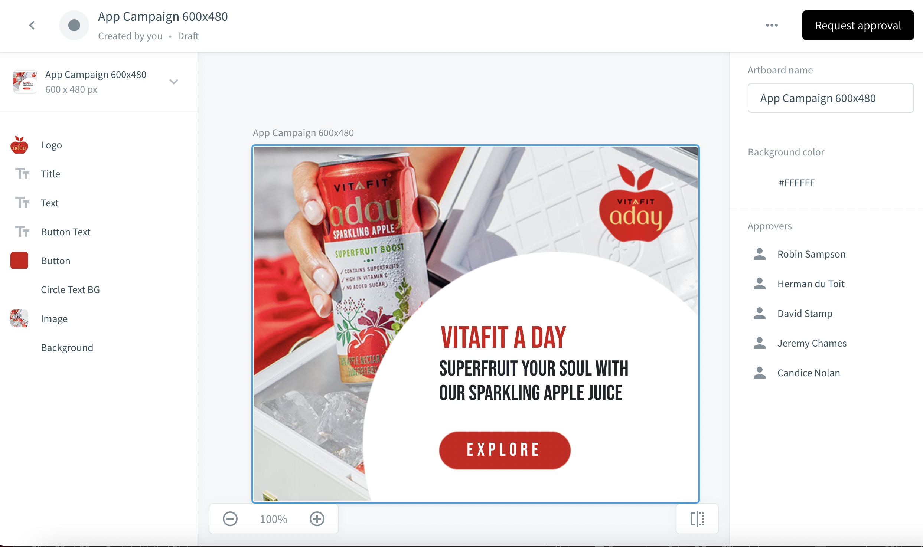
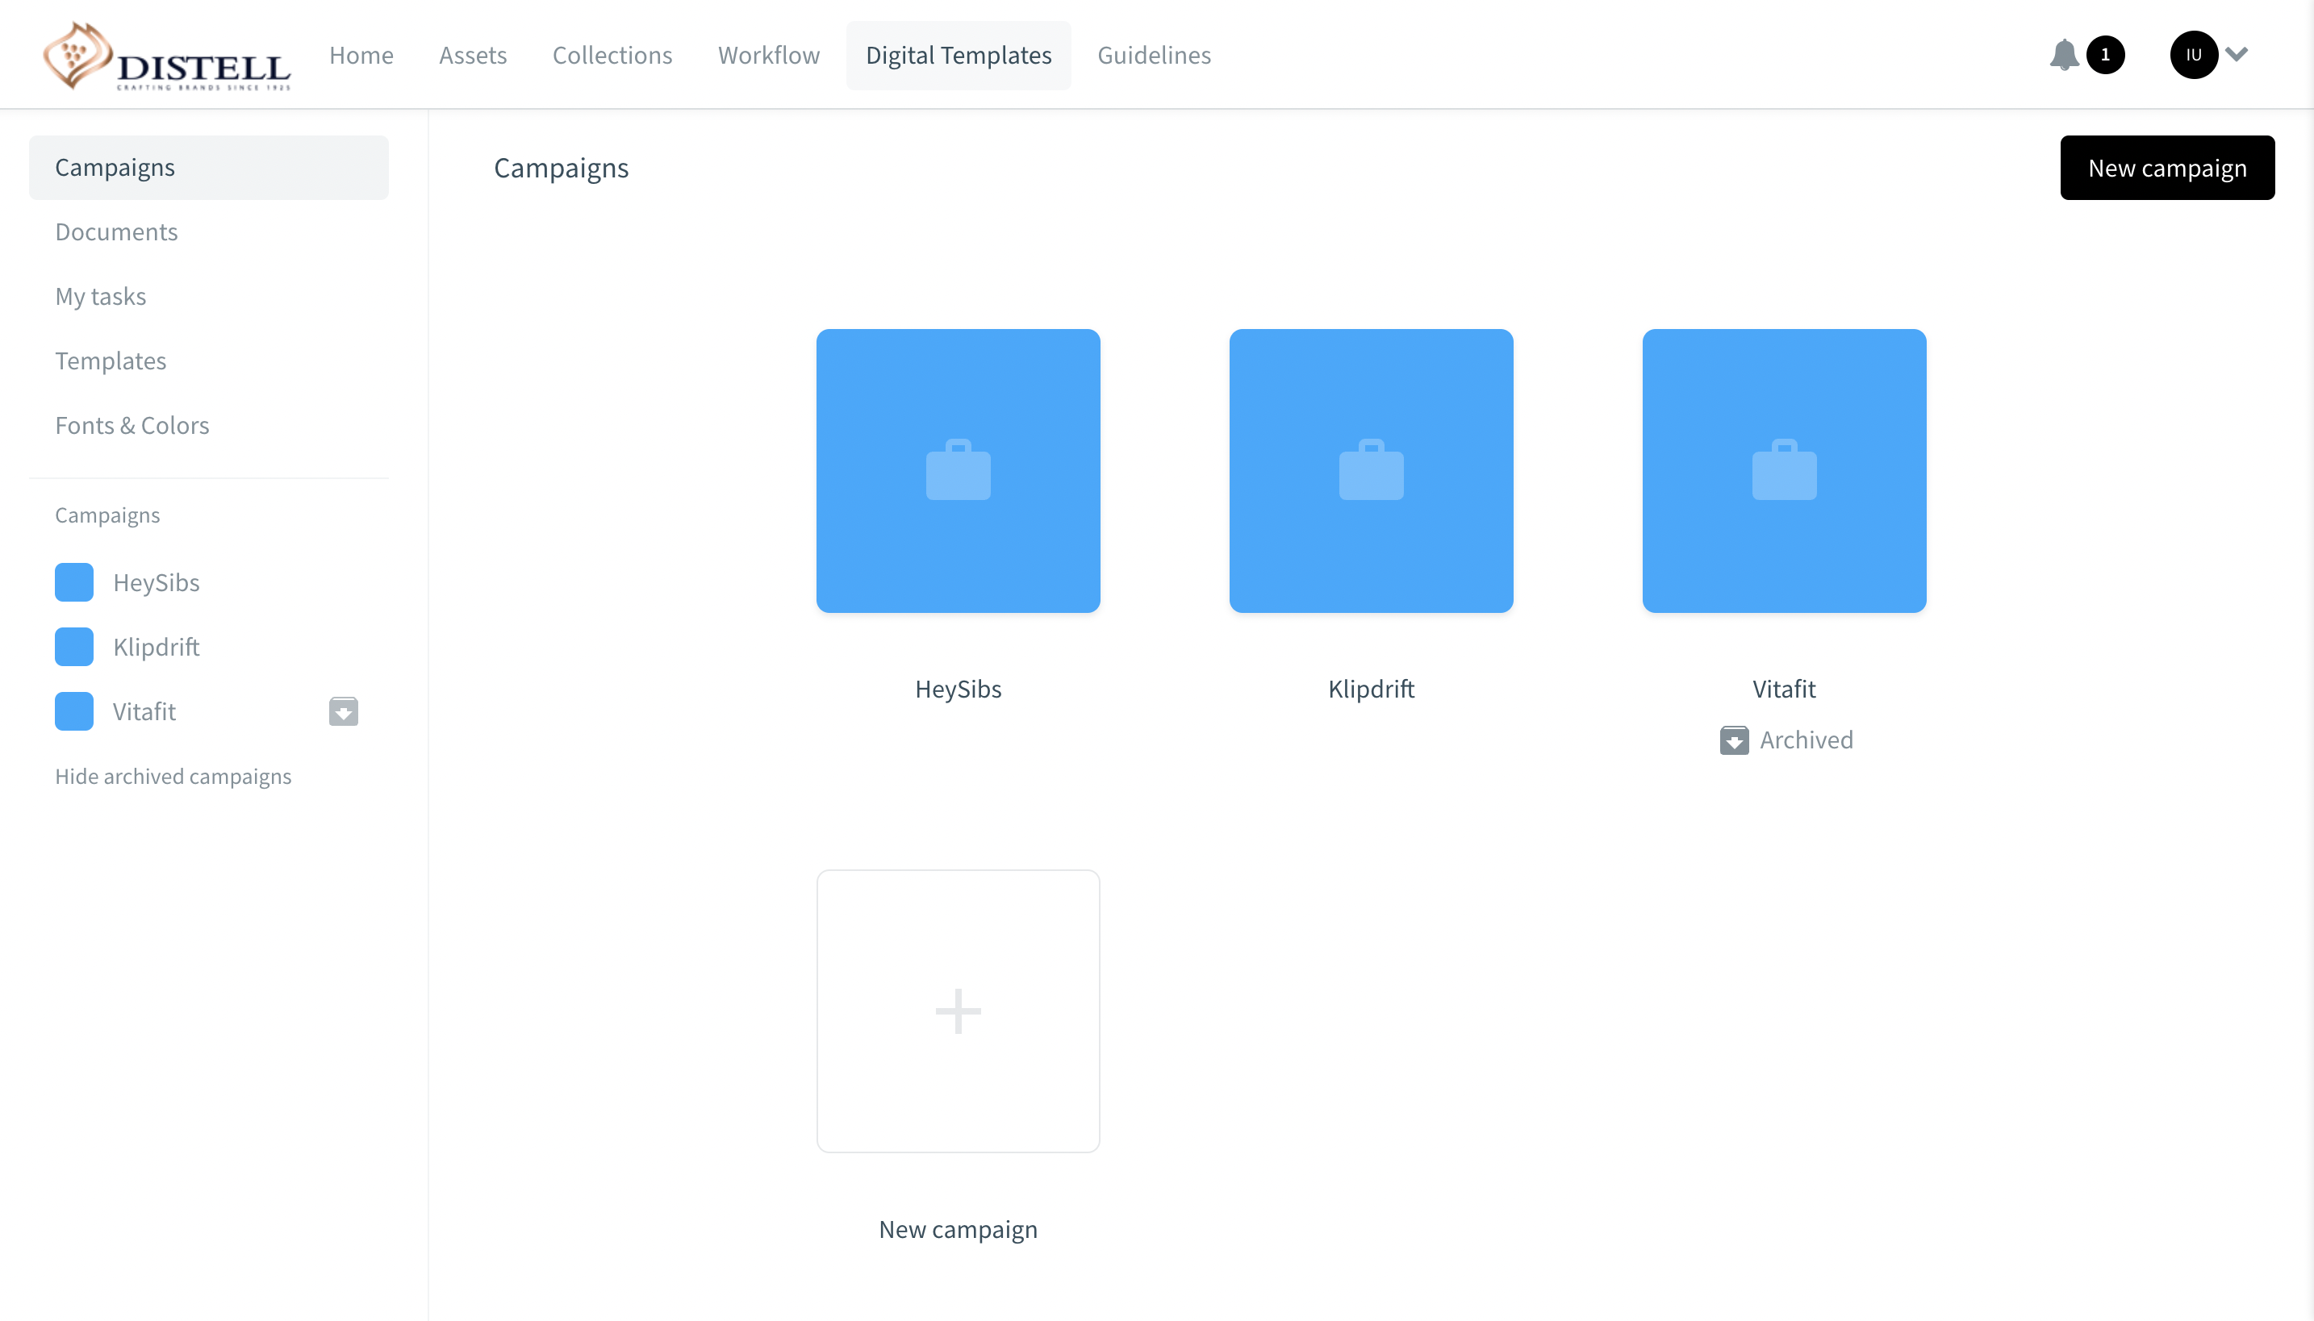
Adapt a Digital Template
Within documents
1
Go to the ’Digital Templates’ section of the portal
2
Click the ’New document’ button and a screen with available documents will open
3
Find the document to create and click its thumbnail
4
Edit the relevant sections
Notes:
In Bynder, you’ll find a bank of available templates for you to adapt in ‘Documents’
Take a look at the templates, (there should be at least one version per channel type), click on create document, and use the template you need to adapt.

Slide 14
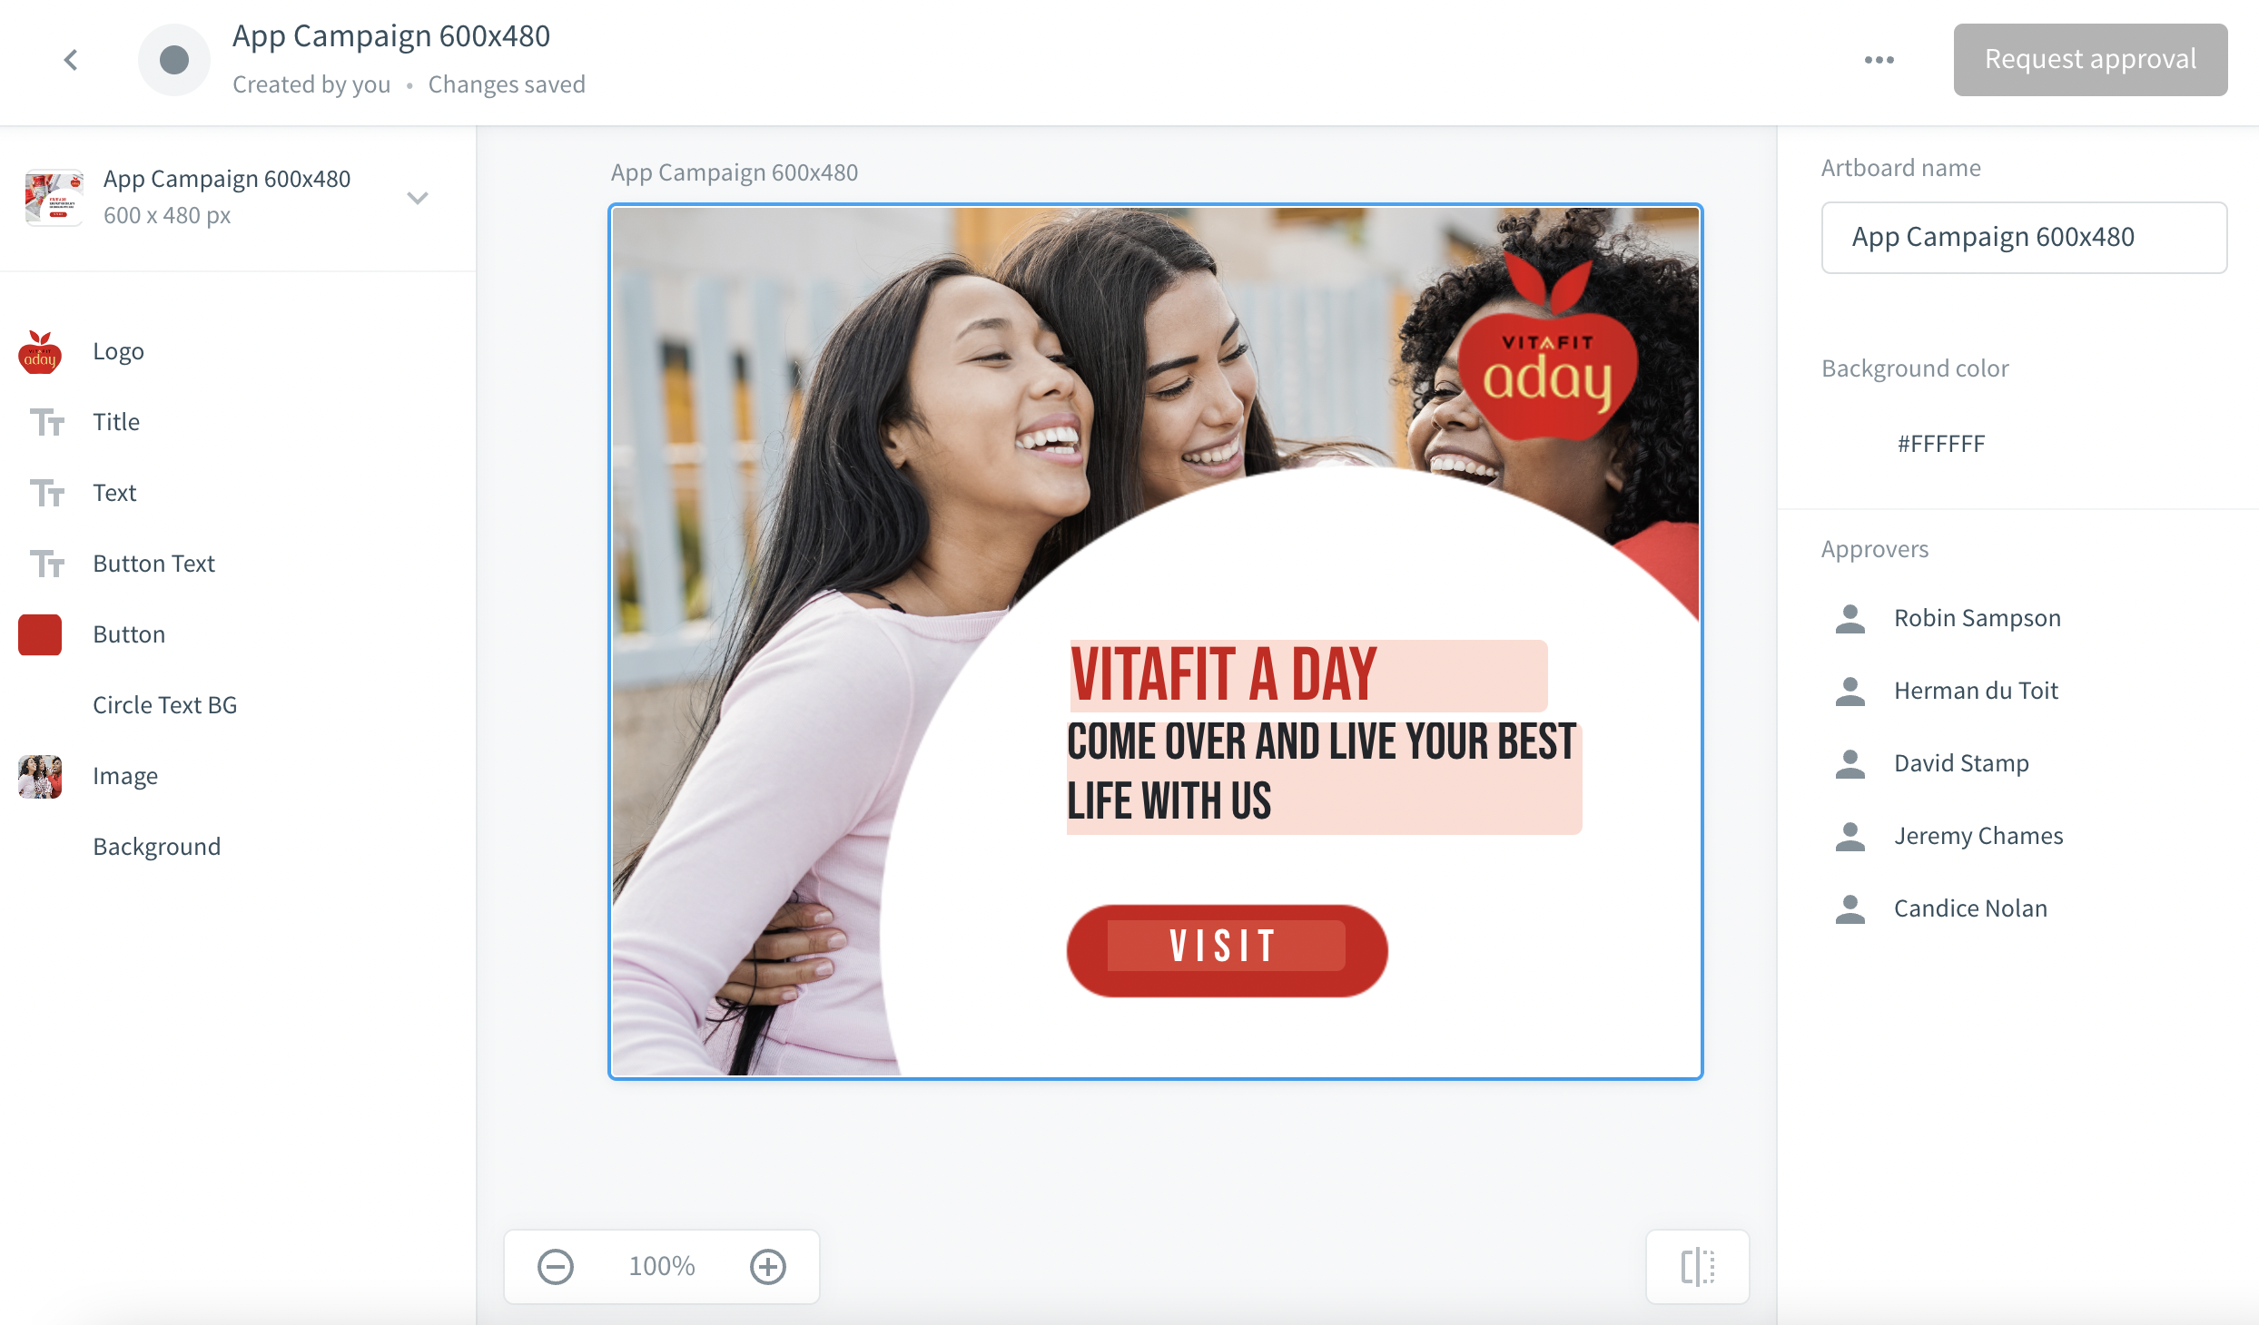
Adapt a Digital Brand Template
Request for approval
Edit template here
Use the sidebars and editor to design the document
Some elements are fixed, others are editable
Preview template
Notes:
This is the menu / page you will see when you’re adapting a template.
Work with the sections on the left.

Slide 15
Use the Digital Brand Template Editor
Artboard name
In the Editor, the name of an artboard can be found above the artboard. Click the artboard & change the name in the
Artboard name
field in the right sidebar
Background
Document name
The name of the document can be found in the top bar. Click the name to change it and press ’Enter’ to save the changes
02
03
If applicable users can change the background colour. Click the topbar and select one of the available colours in the Background colour section.
01
When working in multiple artboard documents the text entered in a linked text layer will be copied to all linked text layers.
Customise text
Click the text layer to customize, remove the default text and enter the desired text.
04

Slide 16
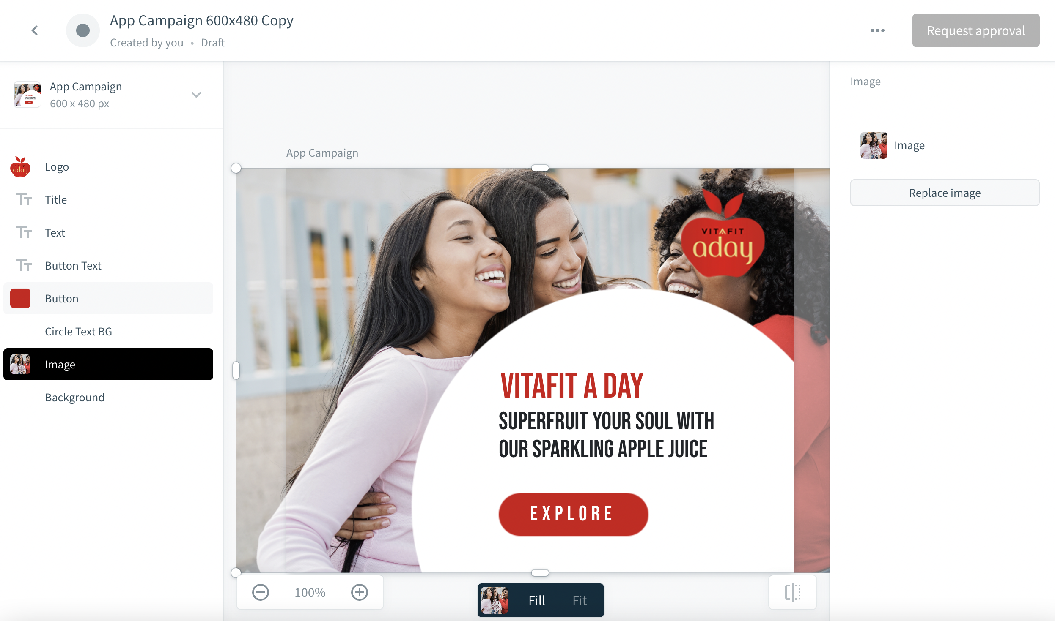
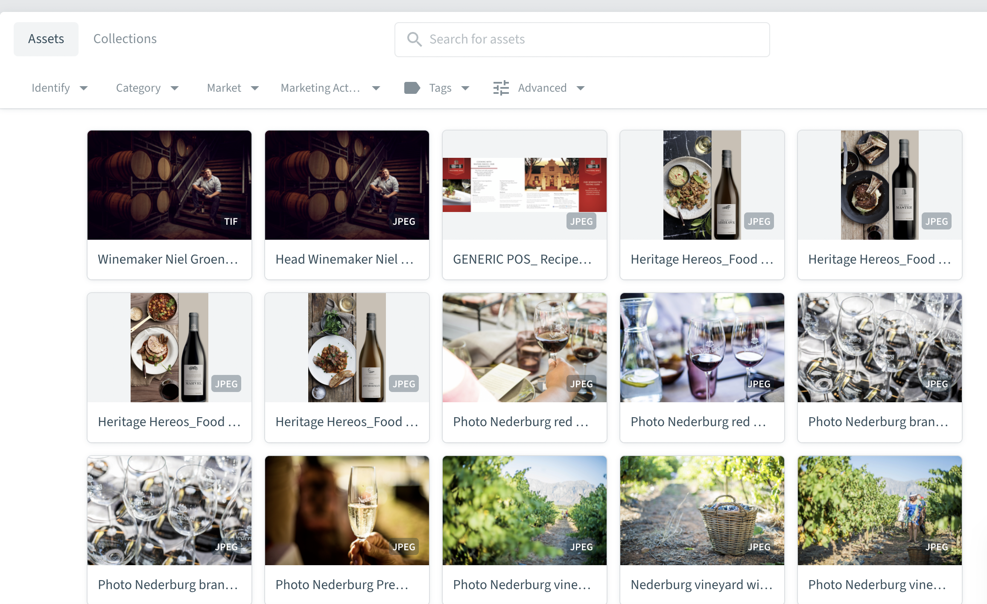
Use the Digital Template Editor
Customize images within documents
1
Click the image layer to customize and then click the ‘Change image’ button to replace the image
2
Depending on the setup of the template, either upload an image by clicking ’Upload image’ or click ’Choose from assets’ to select an image from the Asset Bank
3
Select the image and click ’Add asset’. When working in multiple artboard documents the image added in a linked image layer will be reflected in all linked image layers. Users can still customize the position and scale for each image individually
Notes:
Example of changing background image.

Slide 17
Approve a Digital Brand Template

Slide 18
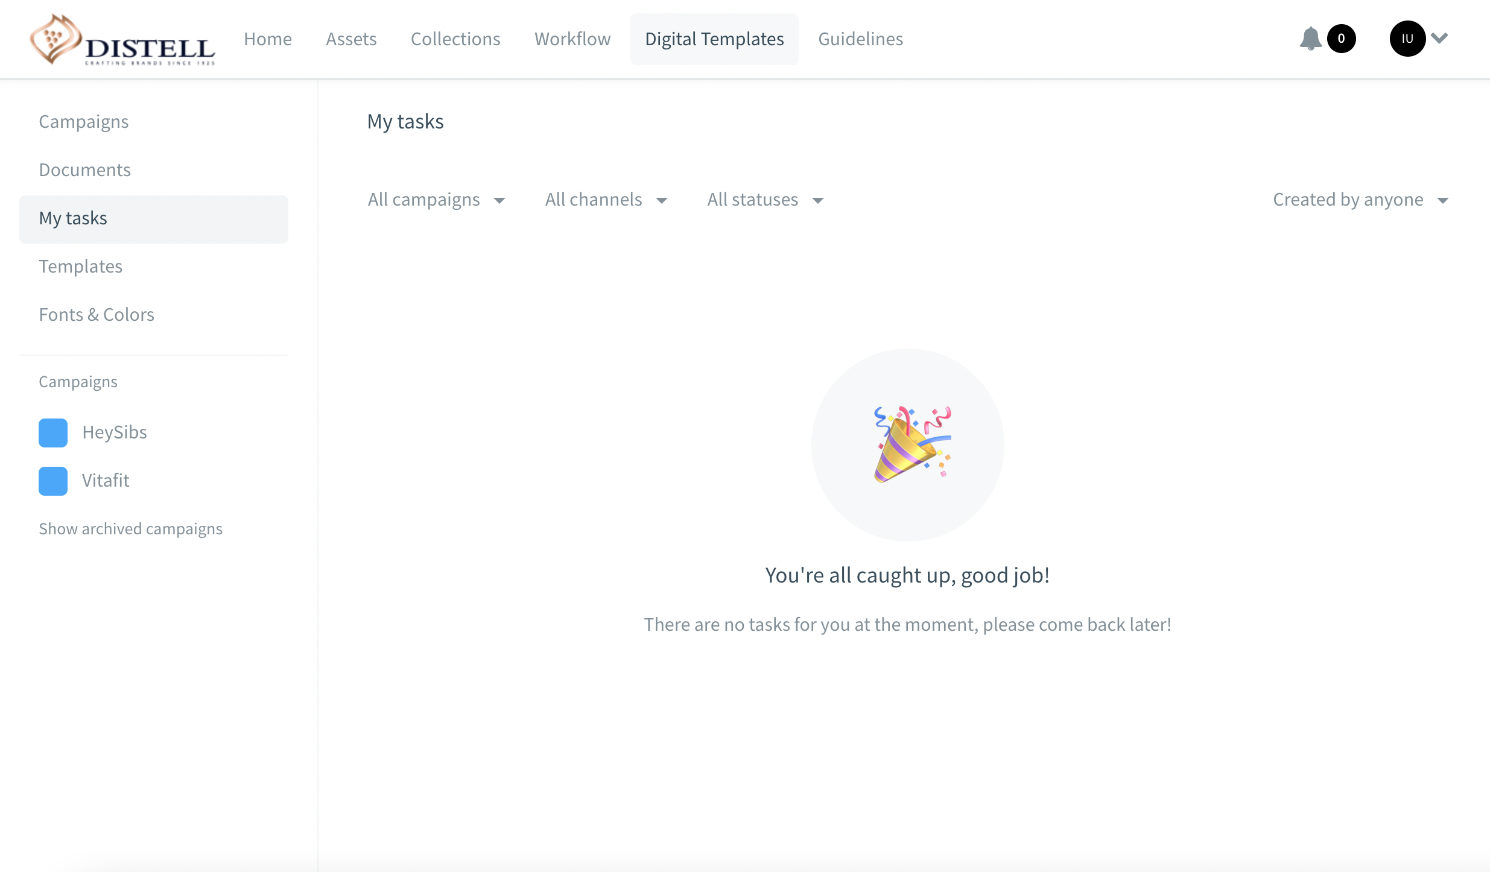
Approve a Digital Brand Template
1
The ’My tasks’ section of Digital Brand Templates stores documents that require changes before they can be approved
2
When a document is pending approval, the approver will receive an email notification.
Click the ’Add your review’ button in the email and check whether the document can be approved or go to the ’Digital Brand Templates’ section of the portal
Click ’My tasks’ in the left sidebar, search the document to review and click its thumbnail
If changes are necessary, click the ’In review’ dropdown and set the status to ’Needs changes’. The user who created the document will receive an email notification that changes are necessary
To approve the document, click the ’In review’ dropdown and set the status to ’Approved’
Once a template has been approved, it can no longer be modified by the creator.
Notes:
Approvals come to the approvers and you will find them in the ‘My tasks section’.

Slide 19
Make changes before approval
When a document is not approved and needs changes, the creator will receive an email notification.
The document will be available again under ’My tasks’:
Click the ’View document’ button in the email received or go to the ’Digital Brand Templates’ section of the portal
Click ’My tasks’ in the left sidebar
Make the changes in the document editor
Resend it for approval by clicking ’Request approval’.
Once approved or if additional changes are necessary, the creator will receive a new email notification
Notes:
If not approved and you need to make changes – you’ll find your instructions in my tasks.

Slide 21
How to get support on Bynder
All the ways you can get support on Bynder
Support URL: https://www.distellwebcontrol.co.za/BynderHowTo
Send an email to:
ivan.engelbrecht@distell.co.za
Notes:
That concludes our 2nd training session.
Here’s a quick recap:
Digital templates – print templates are coming soon feature.
Workflows
And finally, if you need any help, there’s a host of ‘how to’ videos on our Martech portal and if you need help with brand access or functionality access: email Ivan.

