Slide 1
BYNDER TRAINING round 2​
Notes:
Good afternoon everyone!
The aim of todays training session is to improve your knowledge of the Bynder platform, we will go over some more advanced features and directly address a few pain points or issues we have picked up on – so that can ensure everyone is comfortable with the platform.

Slide 2
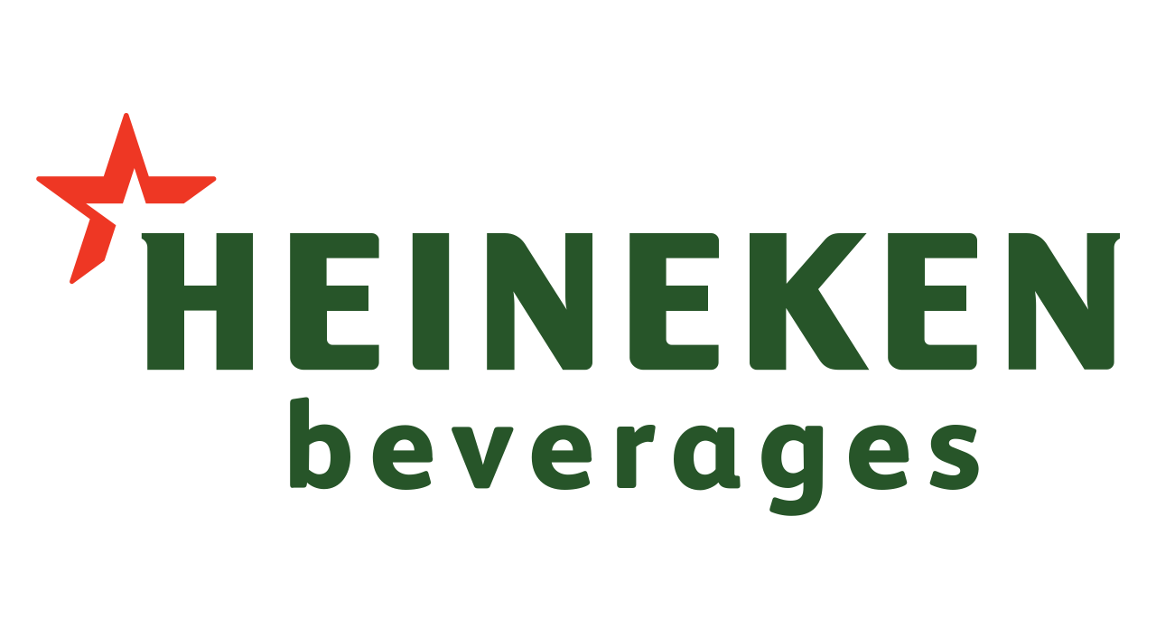
What we will cover in this session
Brief recap of the Bynder purpose and capabilities​
Assets & Collections modules within Bynder​
User Persona’s and key knowledge​
Advanced features and must-knows concerning the Assets & Collections modules​
Notes:
Today’s training specifically concerns the Assets & Collections modules within Bynder. We will specifically be looking at the:
More advanced features within these modules,
The roles and responsibilities of the stakeholders on this call, and
Some crucial must-knows and pain points we have picked up on since the systems implementation.
We will begin by ensuring alignment on the process and function of Bynder, move into the summary of various pain points per user type, and end off with the solutions to each of these pain points that are crucial to your everyday use of Bynder.

Slide 3
Bynder Recap​
PURPOSE
To serve as the single source of truth for all marketing related assets
To serve as a shared digital library to ease collaboration between all parties involved in achieving the organisations objectives.
To house, and protect our owned assets – assets should not be stored on agency servers.
Notes:
Lets begin with a recap:
Bynder’s role within the organisation is crucial as it serves as the single source of truth in the entire workflow chain from campaign ideation, to execution and sales.
To serve as the internal system for all Heineken owned assets. Assets should not be on agency servers.
There are several key stakeholders working to achieve the organisations mission and Bynder serves as the facilitation and collaboration tool between all parties, across the organization.
The application has many notable functions, but the key ones for todays training are: Uploading, Storing, and Distribution of assets

Slide 4
Workflow​
Brand
Agency
Trade Marketing
Sales
Brand provides brief and agency delivers​
Brand/Agency back and forth on creative​
Agency uploads final assets to Bynder​
Trade reviews, selects, and/or adapts creative to suit the customer and the distributes to print and to sales​
Notes:
We have several key stakeholders on the call today, as such we need to discuss the responsibilities of each type of Bynder user.
This slide depicts a generic workflow - Obviously the specifics within this flow can change but the general direction is the focus here, as it emphasises the importance of each user fulfilling their roles and responsibilities within Bynder accurately. As you can see, the sales team rely on the trade team for assets, who depend on the brand team and agencies for up to date, and accurate assets and so on. Therefore, every role plays a crucial part in ensuring a successful execution from the very beginning.

Slide 5
User Type & Detail​
Team​ | User Type​ | Detail​
Brand​ ​ | Team Leader​ | I need to manage, store and distribute marketing related assets. As well as control my brand environment on Bynder.​
​ | Team Member​ | I need to manage, store and distribute marketing related assets. As well as control my brand environment on Bynder.​
Agency​ ​ | Creative​ | I need to upload creative assets for my brand timeously, to view and use.​
​ | Client Services​ | I need to upload creative assets for my brand timelessly, to view and use.​
Trade Marketing​ ​ ​ | Central Team​ | ​Create relevant promotions for trade I need to review assets before print or distribution to sales team
​ | Regional Managers​ | I need to review assets before print or distribution to sales team​
​ | Studio Controllers​ | I need to manage and edit/update various assets in accordance with the sales reps' requirements.​
Sales​ | Sales Reps​ | I need fast access to assets so that I can capitalize on opportunities​
Notes:
Moving on, each user type has specific responsibilities within this workflow:
Brand teams are responsible for maintaining their brand environment on Bynder, and ensuring all assets are up to date and accurate.
Agencies are responsible for loading the latest assets onto Bynder.
And trade teams, are responsible for the adaptation and distribution of assets to the sales team.
Are there any questions at this point? Can I move on?

Slide 6
Brand Team Persona
General Training
Pain Points:​
Modules and features that apply to both personas within the brand team​
Upload
Brand Guidelines
Managing the archiving of assets timeously​
Collections
Asset Navigation
Taxonomy
Ensuring my markets only see relevant assets​
Advanced Training​
Making sure my agency uploads assets timeously and with the correct naming conventions and taxonomy​
Persona specific features and knowledge ​
Workflows
Archiving
Ensuring access controls, concerning who can do what with my brand assets​
Priority features​
Permission Profiles & Controls
Archiving and taxonomy
Notes:
The next 4 slides were developed based off of feedback we have received from various stakeholders. As you can see the key pain points for the brand team are:
Archiving of assets
Access controls
And ease of use for relevant parties
This session will cover everything other than the workflow and brand guidelines modules – these will be addressed and introduced in next weeks training.

Slide 7
Agency Team Persona
General Training
Modules and features that apply to agency personas​
Pain Points:​
Upload
Brand Guidelines
Collections
Adhering to taxonomy
Asset Navigation
Taxonomy
Uploading timeously
Advanced Training​
Persona specific features and knowledge ​
Workflows
Priority features​
Approval Process Knowledge
Taxonomy & naming convention education
Notes:
Agency users in general are mainly concerned with uploading assets in time and to do so, you will need to adhere to the taxonomy and file naming conventions.

Slide 8
Trade Marketing Persona
General Training
Modules and features that apply to both personas within the trade team​
Pain Points:​
Upload
Brand Guidelines
Collections
Version control and accuracy
Asset Navigation
Taxonomy
Multi-brand use case and workflow
Advanced Training​
Uploading assets timeously
Persona specific features and knowledge ​
Print Templates
Advanced Search
Digital Templates
Sharing Features
Priority features​
Their specific (adapted) process using the multi-brand workflow
Archiving & taxonomy
Notes:
Trade teams often have multi-brand campaigns and Studio Controllers need accuracy in order to execute their role adequately.
We understand that there are unique differences between each role within the trade marketing team. For example: Central teams will be concerned with uploading assets timeously and have a much more planned, national outlook. Where regional teams are more personalised, with a focus on individual owners/clients.
However, what is perhaps most crucial for all parties within this team is version control and accuracy, which is governed by brand teams. This is a great example of why we need everyone to use the platform correctly.

Slide 9
Sales Team Persona
General Training
Modules and features that apply to both personas within the trade team​
Pain Points:​
Upload
Brand Guidelines
Collections
Asset availability
Asset Navigation
Taxonomy
Turnaround times to adapt artwork for customers
Advanced Training​
Persona specific features and knowledge ​
Print Templates
Advanced Search
Digital Templates
Sharing Features
Priority features​
Access control​
Notes:
And sales teams, even though not on this call today, are mainly concerned with receiving assets in the quickest time possible.
For those of you who are producing assets in the market, bear in mind that you are also servicing the sales teams who have the same shared goal.

Slide 10
Example & Demo: The Solution
Upload​
Storage & Navigation​
​
Sharing/Distribution
Notes:
There are 3 key actions that concern the Assets & Collections module’s within Bynder.
The Uploading of assets
The storage of assets and the navigational functionalities to find these assets within the platform
The sharing or distribution of assets.
We will address each pain point that falls within these functionalities.
Once again, I need to highlight the fact that Bynder is a shared application across the entire organisation. As such, every action within Bynder affects all stakeholders and not just your own teams.

Slide 11
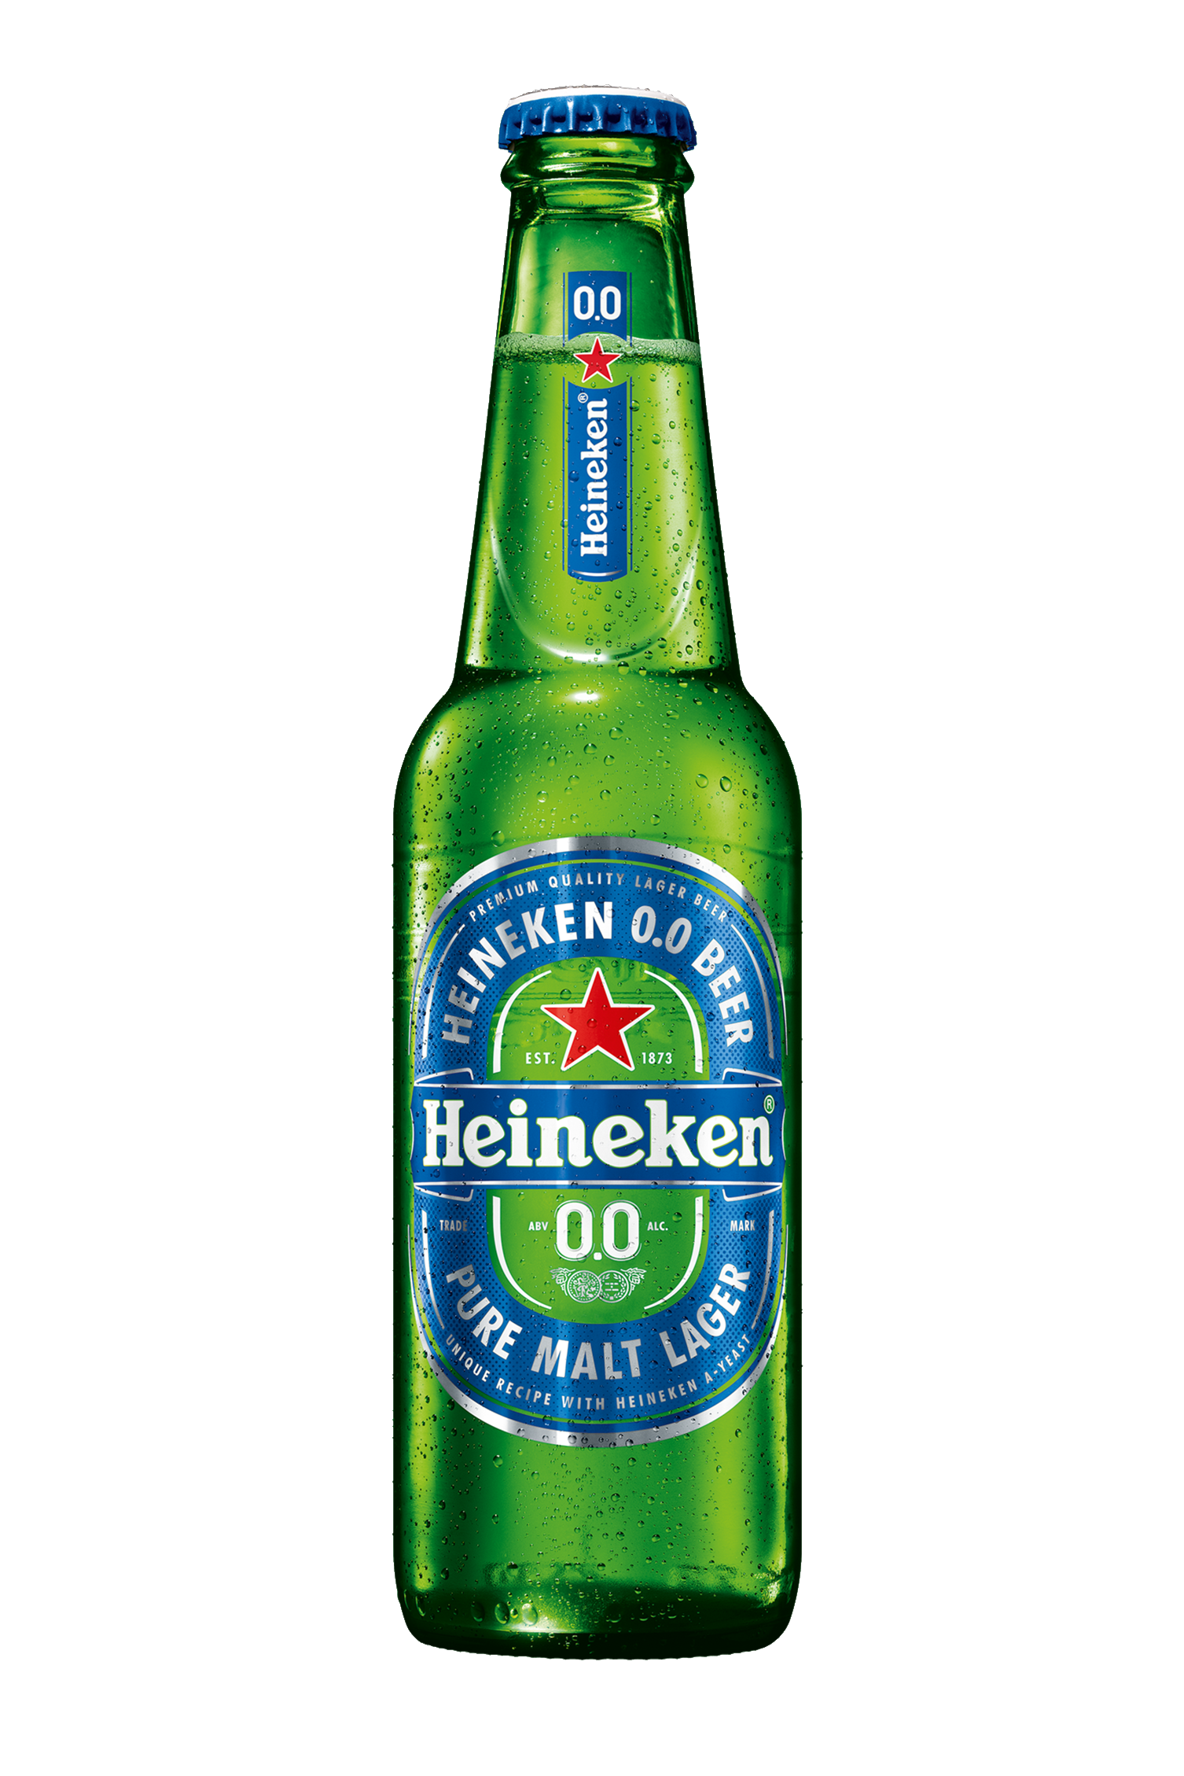
Upload Approval Process
Upload Assets
Waiting Room
System Admin
Published
Logo_Horizontal-01.jpg
Naming Conventions
Heineken 00 Pack Shot 330ml Bottle 2023
Brand Name
Asset Type
Descriptor
Date
*No Symbols
Notes:
Within the upload functionality we have noticed the following pain points:
The upload approval process
The process begins with you upload, which then sits in a waiting room, for one of the system admins to then review and approve/deny.
The system admins check for correct adherence to the taxonomy, as well as naming conventions.
This process generally takes between 1 & 2 hours during the work week. However, if you need immediate approval please fell free to send me an email or message.
Naming conventions
Naming conventions are as follows: Brand name (in full), Asset type, Distinctive descriptor, and date
Another example could be: Hunter’s Logo Horizontal with white background July 2022
NO SYMBOL(S) – this disrupts the ability of Bynder’s search functionality.

Slide 12
Usage Rights
None
Unlimited – no expiration date
Limited – expiration date
Notes:
3. Rights of use
Usage rights are applied in 4 aspects:
Image
Music
Talent
Fonts
Channel
None – self explanatory, as in there are no rights associated with any aspect of this assets, be it channel, talent, music or image.
Unlimited – this means that there are usage rights for this asset, but they are indefinite, as in they will always be there. For example: A custom soundtrack or jingle that forms part of the Brand Identity
Limited – this means that there are usage rights for this asset, but only within a given time period. For example: The use of a brand ambassador for a specific campaign with a start and end date.
For example: you are uploading assets for a campaign with music licencing – this is how you will denote it.
4. Website Updates Process: marking assets as public
Bynder host’s all images that are connected to brand websites.
However, it uses a CMS to do so – what this means is that the image is not actually pasted onto the website, it is being pulled through by a link which is embedded into the website.
In order for this link to display the image, it needs to be marked a public.
This is how to do that…

Slide 13
Website Updates Process
Logo_Horizontal-01.jpg
Bynder
Distell CMS
Website
Notes:
4. Website Updates Process: marking assets as public
Bynder host’s all images that are connected to brand websites.
However, it uses a CMS to do so – what this means is that the image is not actually pasted onto the website, it is being pulled through by a link which is embedded into the website.
In order for this link to display the image, it needs to be marked a public.
This is how to do that…

Slide 14
Accessibility & Control
Access is assigned by brand
There are several permission levels
Screenshot 2023-05-08 at 09.08.11
Smart Filters
Asset Type
Brand
Location/BU
Activity
Notes:
Within the storage & navigation functionality on Bynder we have picked up on a few key features and topics that are crucial to address.
Accessibility & control
Access is assigned by brand
There are several permissions levels within the platform that restrict what users see. Eg. archived assets
Smart filters
Have you been feeling overwhelmed when searching for assets and seeing hundreds of results or what look to be duplicates?
Smart filters are your best friend – they provide a speedy and highly efficient way to narrow down your search results.
Using them is absolutely crucial for optimal efficiency, the search bar may be what is most familiar but it is not as effective as using the smart filters, or both of them in conjunction.
Accuracy of filters is dependent on the accuracy of the upload – show how links to taxonomy

Slide 15
Collections
Works just like a folder, with one key difference
Screenshot 2023-05-08 at 09.08.11
Archiving Assets
Notes:
Collections
Work like a folder, but lacks the ability to create sub-folders
Collections are a consolidated group of assets that share a common characteristic, which has not been covered by the existing metaproperties or smart filters. For example:
Highlight that users must not duplicate the metaproperties within smart filters
Can add assets to a collection in 2 ways, by… (demo)
Archiving
We do not delete assets o
Given the crucial link between Bynder and websites, we don’t allow for the deletion of assets from the portal. This functionality has been entirely removed. Another reason why this function was removed is because these assets belong to us, we need to keep them and their records.
For example: if a BVI has been updated, one will archive the assets using the old BVI, not delete them.
This will remove them from view of the lower permission profile users, as well as clearly indicate that they are archived, and in fact not for use.
However, in the case where perhaps an entirely incorrect asset has been uploaded – please reach out to me and we can either enable temporary deletion functionality for you as an individual, or we will delete the asset ourselves.

Slide 16
Sharing/Distribution of Assets
Logo_Horizontal-01.jpg
How To: 2 methods
NB - Don’t download assets for distribution purposes
Sharing a Link
Public link for users outside of Distell
Private link for internal users
Sharing a Collection
Share feature
Create collection
Stipulate access permissions
Share link
Bynder Express
Notes:
Within the Sharing functionality on Bynder we have picked up on a few key features and topics that are crucial to address.
How to: 2 ways
Access Controls
Functionality Controls
Furthermore, when distributing assets we do so by using on of the two methods just outlined.
We share links only, and don’t download files onto our PC’s or work machines and then distribute them as attachments etc. This is to allow for optimal control and protection of our assets, as well as fast-track the asset distribution process and minimise workload.
Many of you will be familiar with WeTransfer – what you may not know is that Bynder has its own built in we-transfer system. This is easier to use, and provides more control and protection of our assets. This is where it is and how to use it..

Slide 17
QUESTIONS
Support: joshua.purdon@distell.co.za
Notes:
Finally, are there any questions?
The recordings of each session will be shared at the end of the sessions.
Please reach out to me if you require any support or assistance at any time: email on screen

Slide 18
THANK YOU

