Slide 2
Module 1
Finding, downloading, storage & management
Notes:
This module focusses on how to manage Assets in the DAM.
We will cover everything related to: Finding, downloading, storage & management of assets.

Slide 3
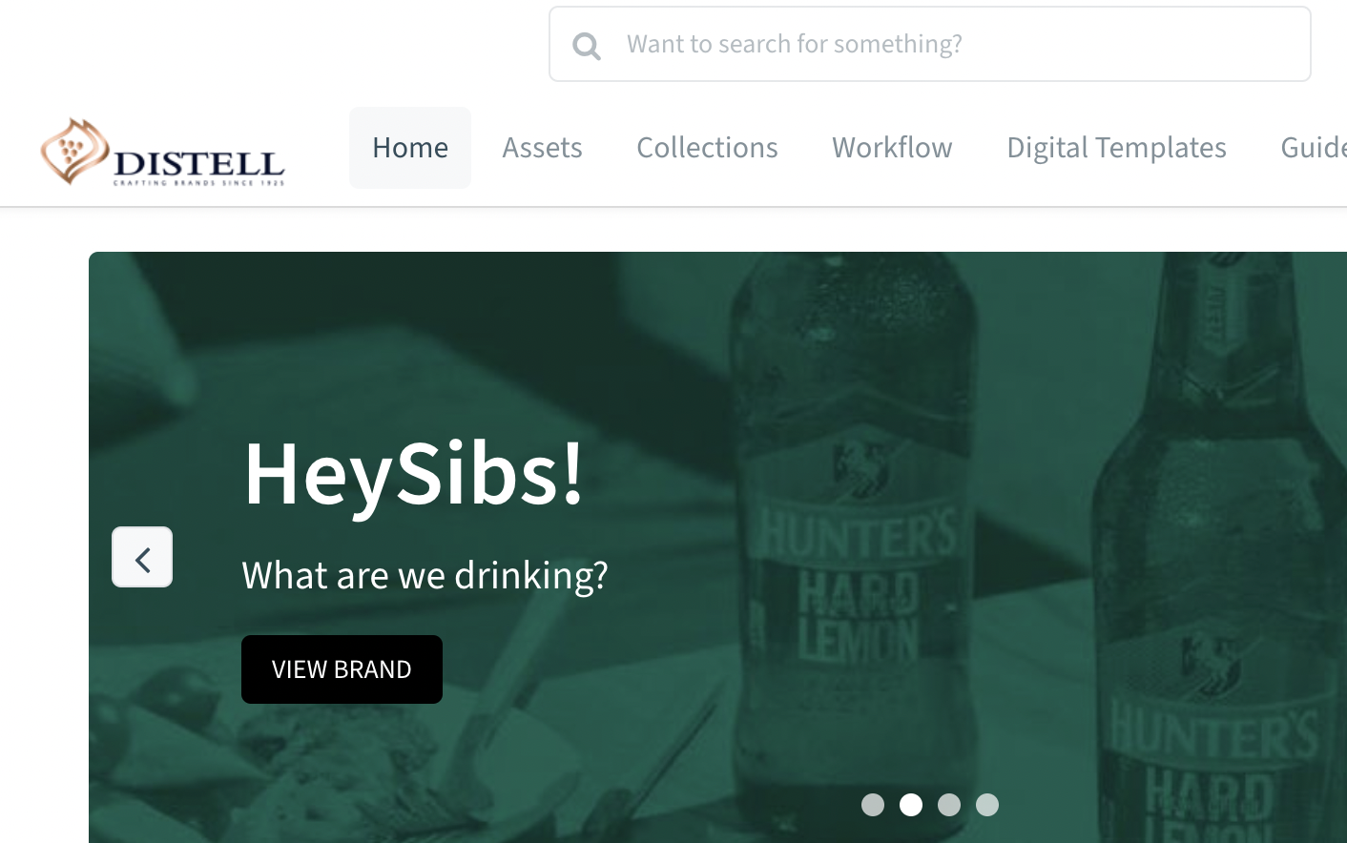
During this session, we will cover four sections:
1
How to use the Search Bar to find assets
2
How to download assets
3
How to upload assets as a logged-in user
4
How to create, share and manage collections
Notes:
In this training session we’re going to cover off the first two functions within Bynder: Assets and Collections.
We’re also going to talk about the Search functionality and how you can use it to easily find assets in the future.
By the time you’re done you’ll be completely comfortable with uploading, downloading, searching for assets and managing and sharing collections.
And, you’ll know how to control who can view, download and share assets.
Sharing assets with your working partners has never been easier.

Slide 4
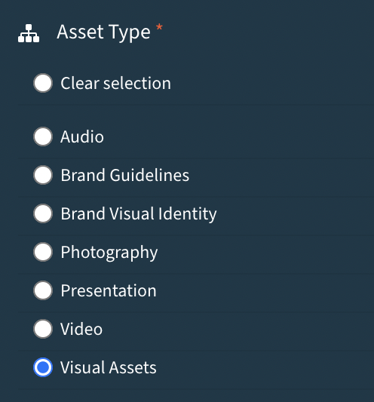
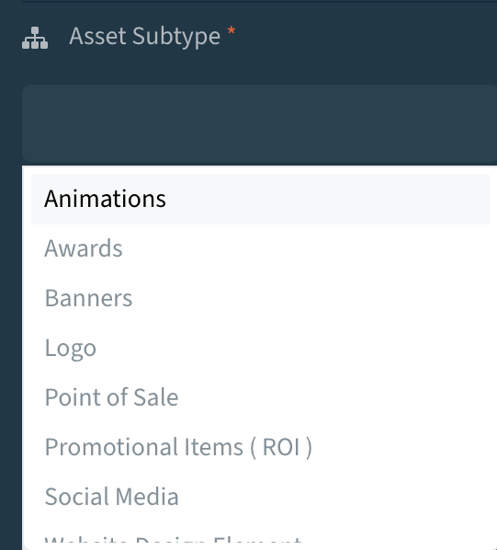
Taxonomy
Taxonomy entails the description naming, and classification of things ​
It helps us categorize information so we can easily find it, work on it, store it and communicate it​
Notes:
Our new, intuitive Taxonomy sits at the very heart of how to work with the assets in Bynder.
It's a completely new Taxonomy from Brand 360, and we truly believe it's for the better. (Some of you might say it's life changing :))
What is Taxonomy? Quite simply, it's the naming conventions we've applied to how you name and store assets at the point of upload.
I think you'll all agree, we weren't very good at applying Taxonomy to our assets in Brand 360- and this made it very hard to find things.
As far as we're concerned, those frustrations are a thing of the past.
Let's take a look: the first step of the taxonomy is naming the asset type: (read from screen menu)
The 2nd step is selecting the subtype which flows intuitively from the Asset Type
There are other steps in the process which are self explanatory but these two are the most important because they focus our attention on WHAT is being uploaded. If we get this right – we'll find exactly what we're looking for every time we search.
If there is something you want to associate with an asset that doesn't exist in the taxonomy, you can always use a tag. Ie: Christmas gifting. Spar promo. Etc.
Last point on taxonomy: it's yours to own. If you want us to add in asset types or make any changes, feel free to use the suggestion box.

Slide 5
Notes:
There is another piece of good news.
We understand how important it is to get this right, therefore we've dedicated a role to quality proof all assets as they are uploaded.
Their responsibility is to work with all of you to ensure the taxomony is correctly applied to all uploaded assets.
Here’s how it’s going to work (read from screen).
It may be slow going in the beginning, but pretty soon we’ll all be familiar with the new taxonomy and fitter at uploading assets with complete taxonomies.
Remember – this is all about enabling Bynder to ‘index’ assets for easier and intuitive searching.

Slide 6
How to use the Search Bar to find assets
Notes:
Now that we've covered off an understanding of the taxonomy. We can talk about search.

Slide 7
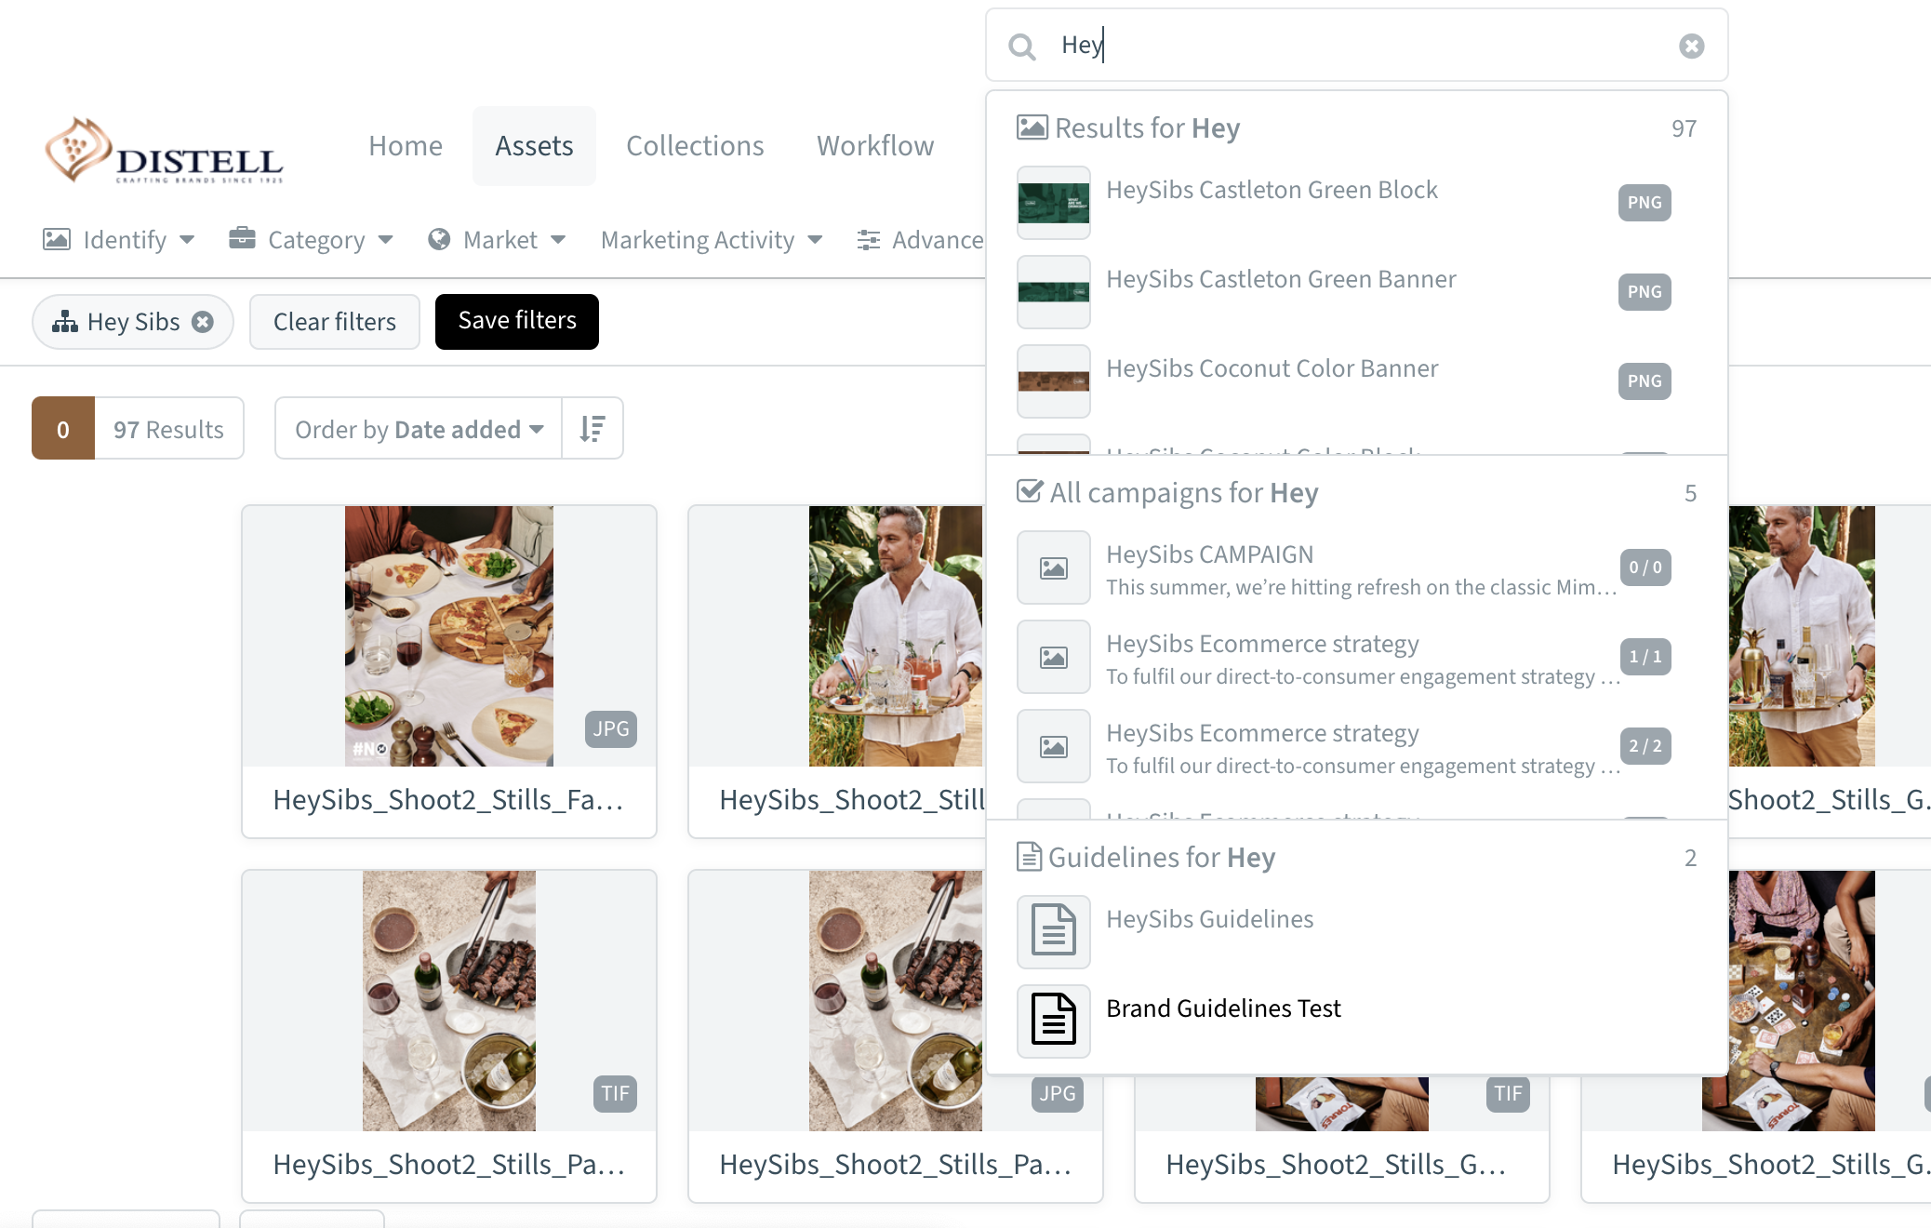
How does the ‘Search’ function work?
Alongside the asset name, the system allows users to search on titles, descriptions, tags or collections
Notes:
In simple terms, think of using Bynder search the same way that you use google search.
Type in what you're looking for and check your search results. (Remember – now that you understand the taxonomy, you can be prescriptive with your search keywords)

Slide 8
How are the search results ranked?
The asset title
Assets that match your search criteria will be given a score.
The results are shown in a descending order based on that score, and the media that best matches your search criteria will be shown to you the first
The tags with which the asset is tagged
The metaproperty options with which the asset is tagged
The highest score will be given when the search matches
Notes:
Search rankings work like this:
The asset title and tags have the greatest impact on your search rank.
You’ll be familiar with the campaign and date ranges as well, so you can also include these in your search.
(Remember to make use of tags when uploading to make search work for you.)

Slide 9
Tips when searching
Miss Jones Science Class
" "
AND
AND NOT
01
Receive the results that exactly match what you searched for
02
Search for assets that contain all the terms from the search phrase
03
contain one or the other term from the
searched phrase AND EXCLUDES
Notes:
For those of you who want to ‘sweat’ search, this is for you:
To find exactly what you’re looking for: type in exactly what you’re looking for and use quotation marks.
If you’re not sure what you’re looking for and are prepared to do a bit of scrolling, use AND ie: Three Ships AND posters. This will extend your search parameters.
If you know you need to scroll to find what you’re looking for, but you know upfront that you can exclude some items from your search, use AND NOT.
Ie: Three Ships table talkers AND NOT posters.

Slide 10
How to download assets
Notes:
Section 2: How to download assets

Slide 11
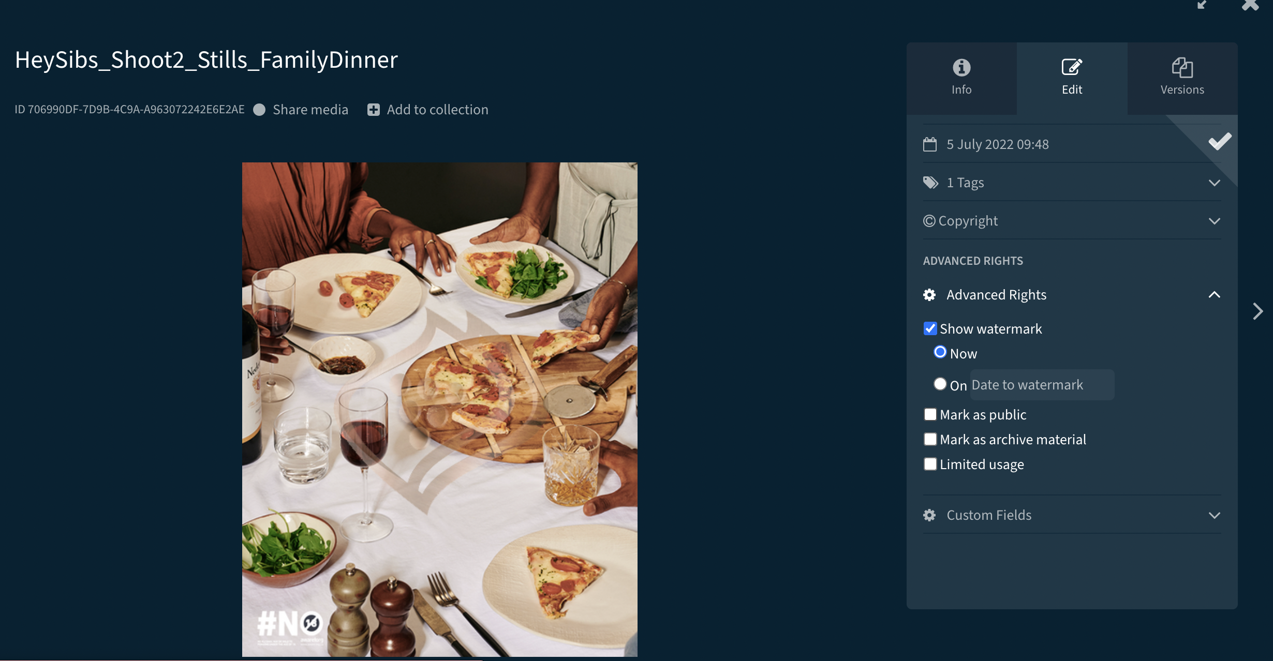
How to download Assets
Downloading in Bynder is governed by permissions granted to each user
Bynder allows approved users to download the original asset file and the available derivatives
Notes:
If you’ve ever downloaded anything from the internet before, then this shouldn’t be foreign to you.
Pay close attention to the permissions attached to the asset.
You may need to contact the asset owner for permission to download- and we’ll show you how to handle that in a bit.
You can choose to download one file, or multiple files.
It’s as simple as choosing the files you want, and then downloading.

Slide 12
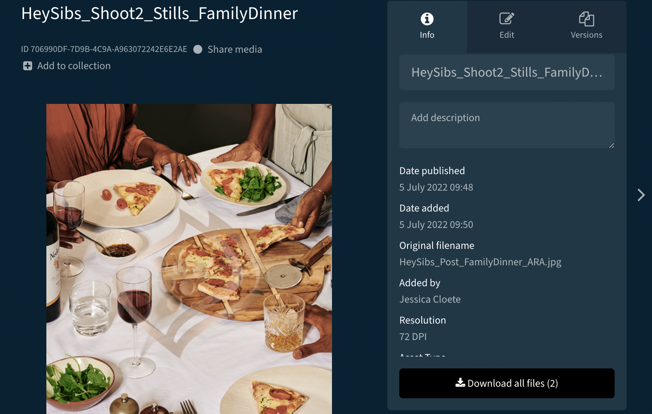
How to download original asset files
When downloading from the asset detail view, click the download button in the right sidebar
Click “Download all files” to download the original asset files
Notes:
Here’s another great thing about Bynder.
Every time a file is uploaded onto Bynder, the system automatically generates a number of derivative versions of the file.
For example: high res jpeg, low res jpeg, pdf version etc.
For video, think low res that’s easy to share.
So no more having to ask for a version for your presentation, or to quickly send someone for commentary.
The versions are all ready for you on Bynder.

Slide 13
Uploading Assets

Slide 14
Uploading multiple files
A maximum file size of 50 GB
There are multiple ways a user can upload media to the Asset Library
Group assets with similar taxonomies
Go to Settings > Users & rights > Permission Management to verify permissions
A maximum file resolution of 25,000 by 25,000 pixels
A maximum of 250 files per bulk upload
Restrictions on upload
Notes:
You can upload one file at a time, or multiple assets at a time.
There are some limitations when uploading multiple files: (Read from the screen).
A good rule of thumb here would be to upload groups of assets with similar taxonomies.
This is usually the time when you determine access rights to assets. Use: (read from screen)

Slide 15
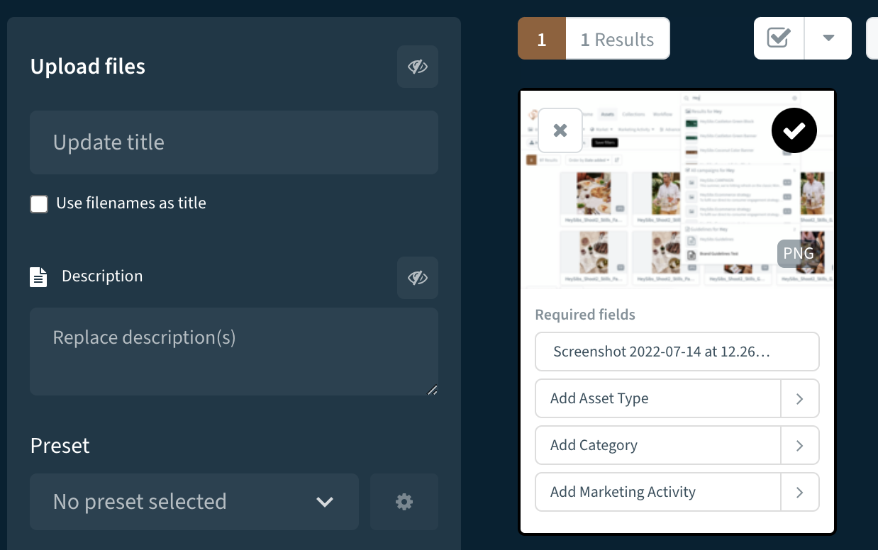
Upload assets using drag & drop
User options include:
Drag and drop the files onto an Asset Library page and the upload will start automatically
Click the Upload media button in the Asset Library, and select the files to upload
Update asset information for one or multiple assets:
Click to edit and update multiple files
Enter the title for the asset
Add additional metaproperty options for the assets
Expand the tabs and add the required information about the assets
Notes:
There are two ways to upload assets: drag and drop, OR use the upload media button.
Remember to apply the taxonomy and permissions at upload.
A good way to think about the taxonomy is to consider how someone would use search to be able to find the asset later.
And Tags help add that extra bit of detail.

Slide 16
Upload assets using drag & drop
Click to activate additional fields to add extra information to the assets
Notes:
Here is the icon you check to add additional information to the upload.

Slide 17
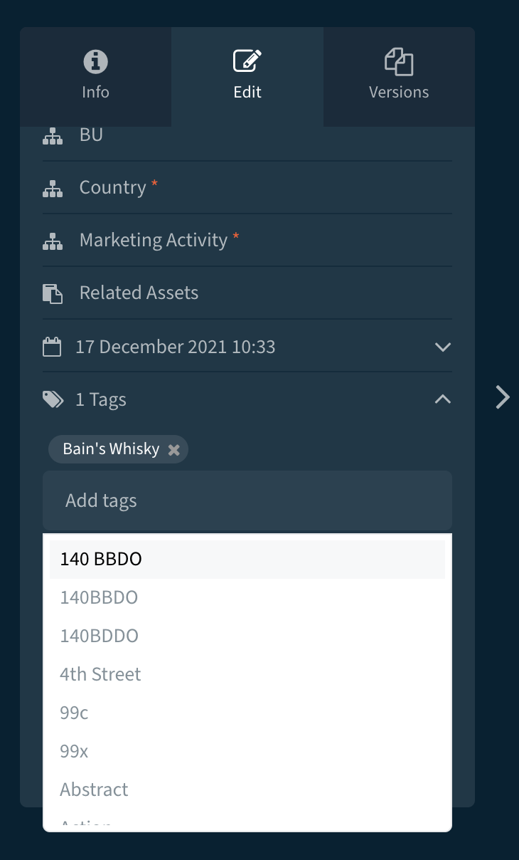
Upload assets using drag & drop
If users want to add specific information to single assets, they must clear the checkbox on the asset and add the information directly in the asset preview.
If they want to go back to editing all assets, select the checkbox again and add the information in the tabs
Notes:
Bear in mind with multiple uploads, you may need to go through the assets one by one and double check the taxonomy and tags.

Slide 18
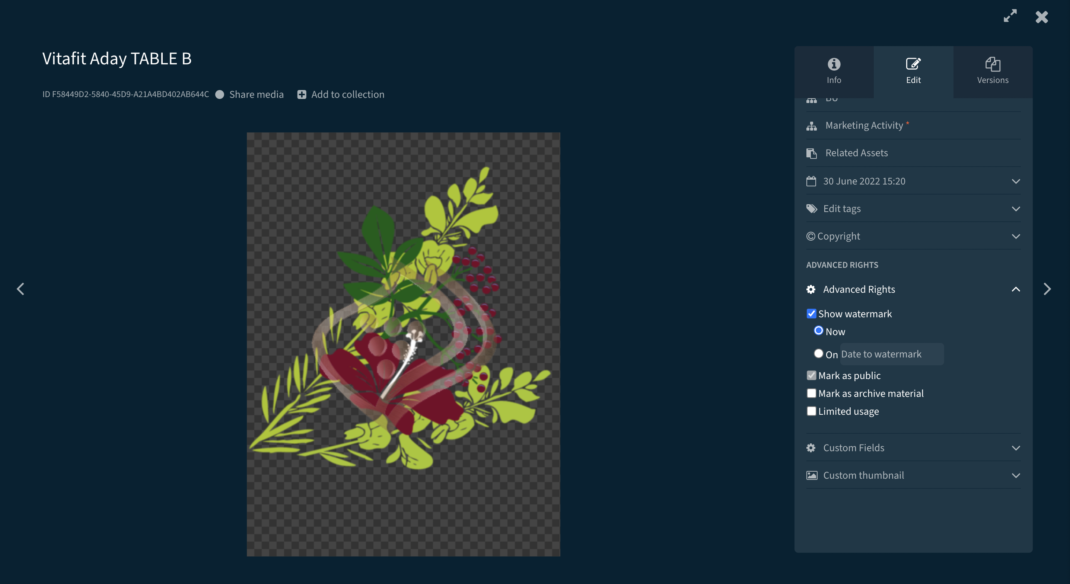
How to apply watermarks
Go to your portal and start the asset upload
Go to the Advanced Rights section in the left sidebar of the upload screen.
Select Show watermark.
(Optional) Choose when you want to watermark the asset
(Optional) Apply other metadata to the assets.
Click Store selected files to finish the upload.
Notes:
Because we

Slide 19
Create, share and manage collections
Notes:
Section 4: Create, share and manage collections

Slide 20
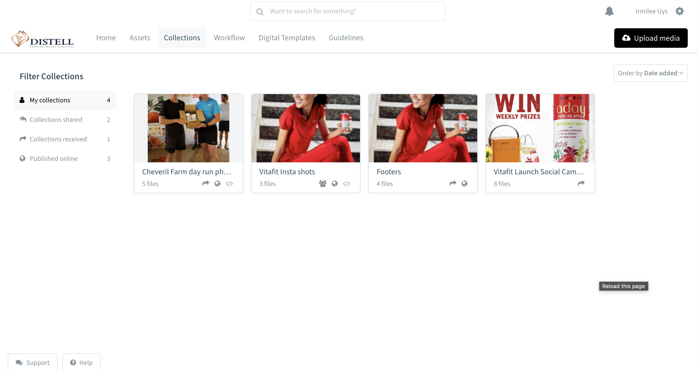
What is a collection
A collection is a selection of assets that have been added together, for a specific reason, by a user e.g. a campaign or a project
1
Creating groups of assets that belong together as collections allows users to share all the material, in one logical place, with other internal and external users
2
3
Collections, by default, are not publicly available and can only be accessed by those who have the permission to view the collection
4
Only the owner of a collection can manage and edit the collection
Notes:
A collection is a selection of assets that have been added together, for a specific reason, by a user e.g. a campaign or a project.
It makes it really easy to share assets with someone by grouping them together.
Typically collections are not publicly available, so someone will only see it, if you choose to share it with them.
Collection permissions are at the behest of the collections owner only.

Slide 21
View A Collection
Users with the right permissions can use the
’Show collections from dropdown’
to view the collections from other users and/or the collections other users shared and/or
received
01
Go to the ’Collections’
overview page
02
‘Filter Collections' menu allows users to view collections that are created, shared, received and published
online
03
Notes:
To view collections you have access to, or to manage your own collections, go here:

Slide 22
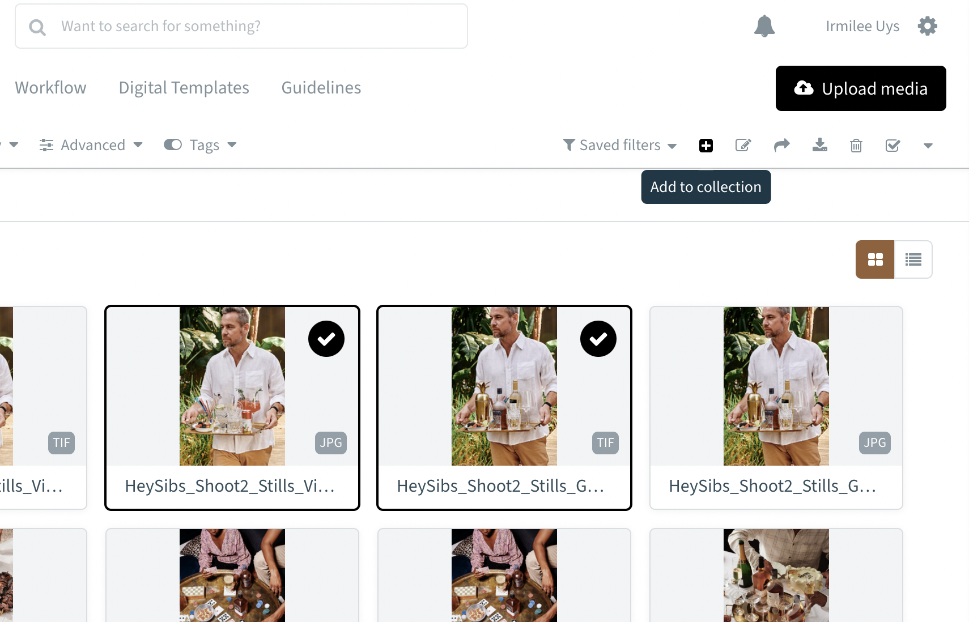
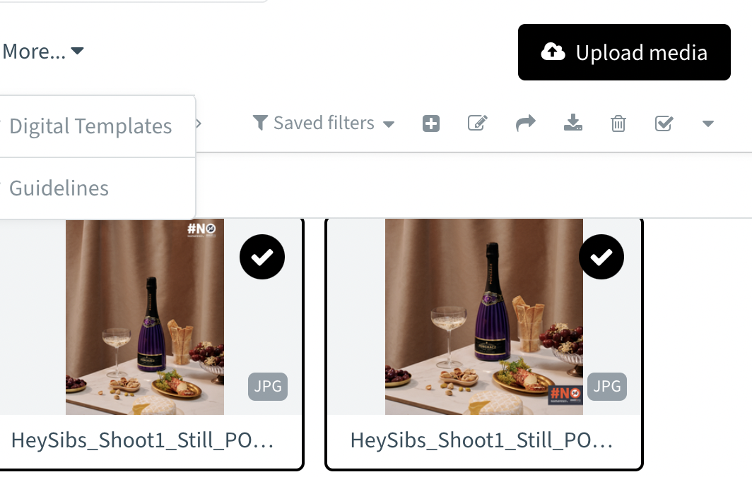
Create a collection
1
Go to the Assets Overview page
2
Select the assets to group
3
In the action widget, click the plus icon
4
Decide to add assets to an existing collection or create a new one
5
Click ’Add to collection’
Notes:
If you want to create a collection, there are two ways of doing this.
Groups assets together, click add to collection.
Or, create a collection, and insert the assets.

Slide 23
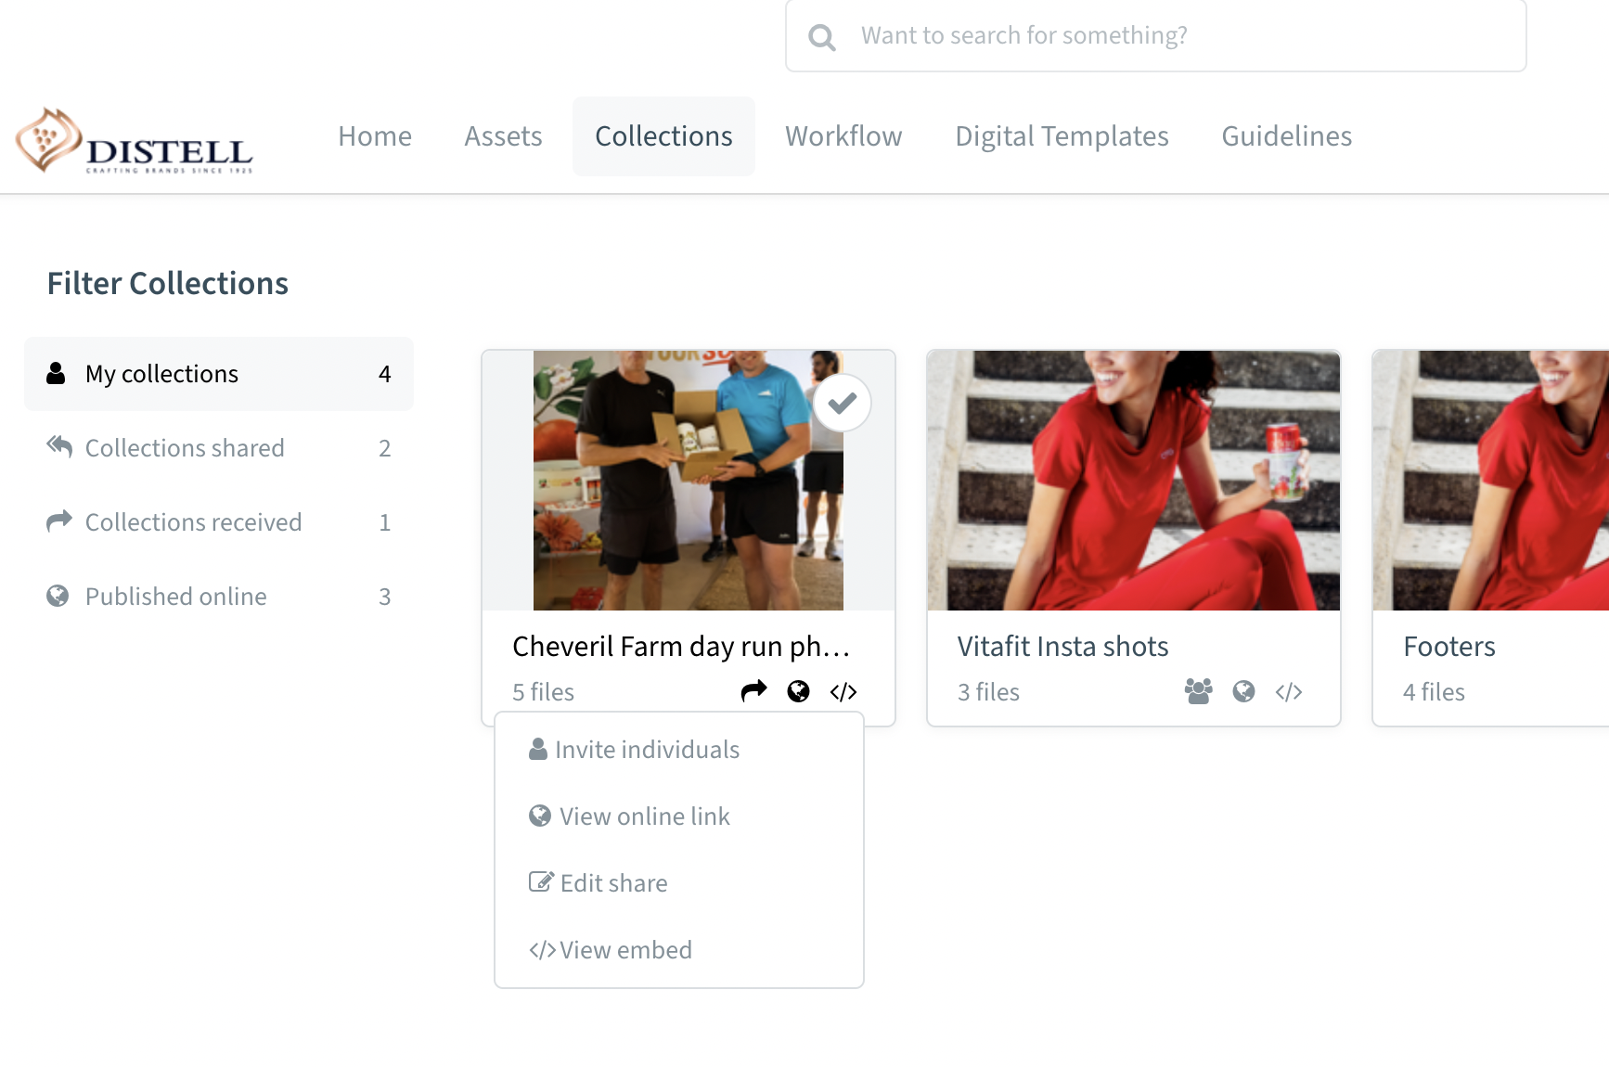
Manage a collection
1
Go to the ’Collections Overview’
2
Select one of the available options:
Share collection
Who has access
Embed collection
Publish online
Notes:
You can control who can view, download a collection, as well as publish it into website.
If you make a collection public, it also means that the person you’re sharing it with doesn’t have to be a Bynder user – they can simply click on the link.

Slide 24
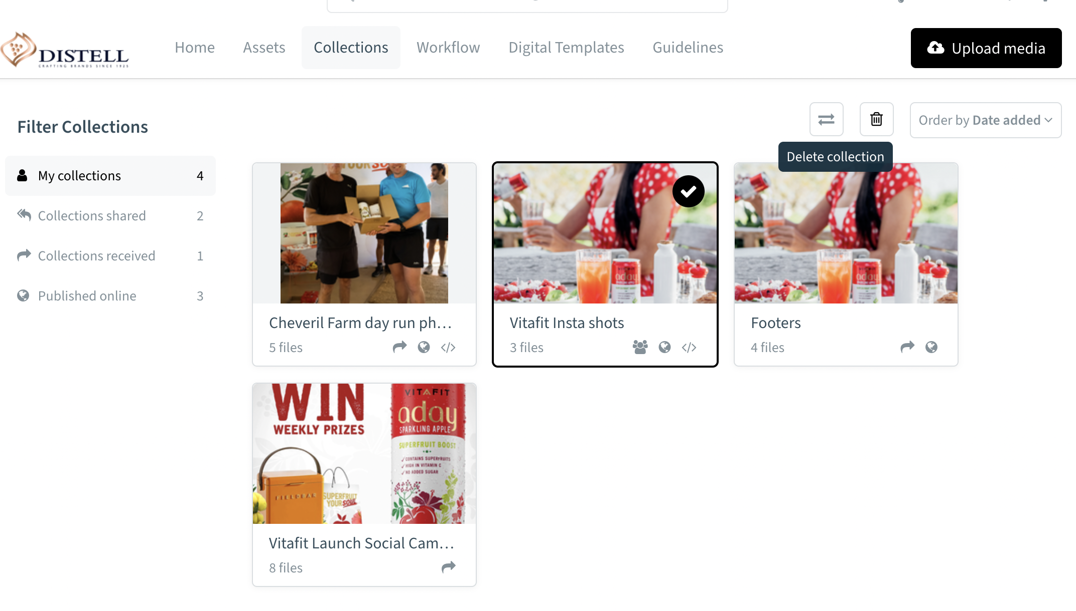
Delete a collection
Users can only delete their own collection
When an administrator or content manager needs to remove somebody else's collection, they must ask the collection owner to share the collection with them, including managing rights or to transfer the collection ownership completely
Notes:
Only users can delete a collection. Keep this mind when you have changes in your teams, and transfer collections ownership timeously.

Slide 26
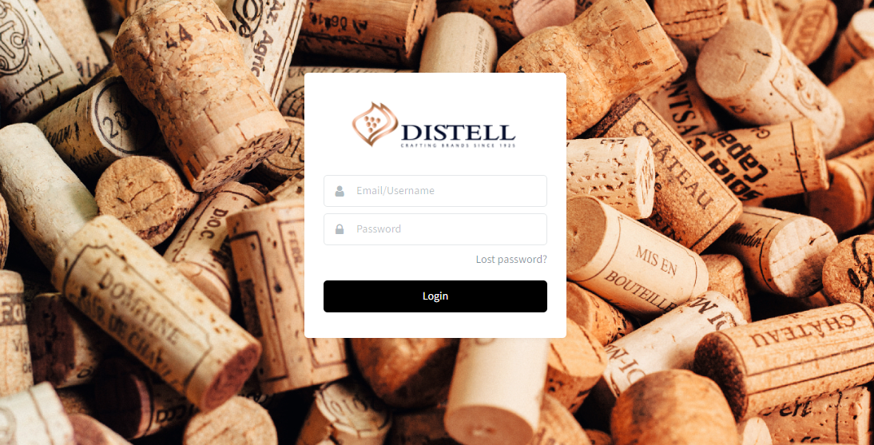
Let’s get started on the Bynder Adventure
Log into Bynder
Access the page where you log in to your Bynder portal
https://dam.distell.co.za/
Check:
Do you have access to the right brands?
Do you have access to the right features you need?
Need help? We’ve designed a support portal too.
Notes:
You should all have your logins by now, and the correct permissions by brand.
If this is not the case, contact your administrator and we can help get you up and running.
We’ve also introduced a support portal where you can access all the help you need to get started.

Slide 27
How to get support on Bynder
All the ways you can get support on Bynder
Support URL: https://www.distellwebcontrol.co.za/BynderHowTo
Send an email to:
ivan.engelbrecht@distell.co.za
Notes:
That concludes our first training session.
Here’s a quick recap:
We’ve given you an overview of the full power of Bynder.
You know how to access assets, download and upload.
Same for collections.
You know how to control access to and share assets and collections with others.
And finally, if you need any help, there’s a host of ‘how to’ videos on our Martech portal and if you need help with brand access or functionality access: email Ivan.

