Slide 1



Slide 2
Content Management Training
Notes:
Today we’re going to talk to you about the CMS, but we are actually showing you two things:
The CMS AND version control.
We’ll talk to you about what Agency do/ website team do.
Inform you – it’s already happening.
Distell webcontrol is change control.

Slide 3

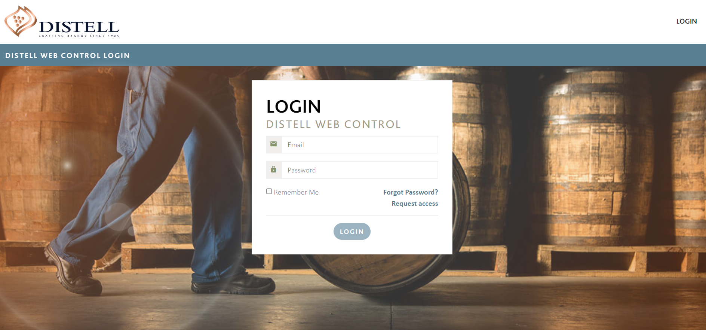
Why were you invited to this session?
To understand what a Content Management Solution is
To understand the need for a Distell Content Management Solution
To learn how to use the Distell CMS
Notes:
What is a CMS? CMS stands for content management system.
It is a software application that allows you to build and manage a website without having to code it from scratch or know how to code at all.
It enables users to create, edit, collaborate on, publish and store digital content via GUI

Slide 4
Why a Distell CMS?
The Distell CMS serves as a consolidated content management system for all websites owned by Distell.
A consolidated CMS provides:
Security Advantages
Brand & Code Quality Control
Automated Image Version Control
Structured & Standardized Change Management
Cost Management
Publish Once/ Read Many
POPIA Data Control
Data Form Consistency
Consumer Data Tracking & Management
Notes:
Partner-Us’s CMS has been used for Distell.co.za since 2004.
Distell has decided to use the Partner CMS to manage content of the Brand websites as well.
This will be achieved by a combination of websites managed directly by the CMS and WordPress websites managed via an API.
The CMS will also be used to keep DAM assets used on websites up to date.

Slide 5
Website migration to the CMS
Current websites are being migrated to the CMS in the following sequence:
Non-WordPress websites
WordPress without the Distell WordPress plugin
Holding sites
Small and non-active WordPress sites
The rest of the WordPress websites will stay on WordPress using the updated plug in for database activity i.e. Amarula.com
Notes:
The migration will run until the end of September 2022
Current sites that waiting to go live:
vitafitaday.co.za
cocktailfinder.durbanvillehills.co.za
countpushkin.co.za
espritofficial.com
threeshipswhisky.co.za
Richelieu.co.za
Viceroy.co.za
Moniswines.co.za
Vawter.co.za

Slide 6
Website migration to the CMS
1 Non-WordPress websites
countpushkin.co.za
2 WordPress without Distell plugin
3 Holding sites
Drostdyhof.com
4 Smaller and non-active WordPress sites
extreme-energy.co.za
klipdrift.co.za
htr.co.za
gordonsgin.co.za
bainswhisky.com
hunters.co.za
G2
Publicis / Liquorice
cocktailfinder.durbanvillehills.co.za
threeshipswhisky.co.za
WPP
viceroy.co.za
Singh & Sons / G2
Publicis / Liquorice
vawter.co.za
International team / Singh &Sons / Liquorice
Drostdyhof.co.za
Singh & Sons / G2
Partner-Us
Publicis / Liquorice
Hoorah/ WPP
WPP
jamessedgwickdistillery.co.za
Richelieu.co.za
G2
capefinerarewine.auction
4thstreet.co.za
espritofficial.com
twooceanswines.com
Sites live on CMS
savanna.co.za
Tanzaro.co.za
Vitafitaday.co.za
HeySibs.co.za
WPP
bernini.co.za
themasterscollection.co.za

Slide 7
Using the CMS
1
New CMS Website Or Template
2
Update CMS Website Or Template
Notes:
There are 2 ways to use the CMS – either for setting up a new website or to update an existing one.
The following slides will walk you through both processes

Slide 8

New CMS Website or Template

Slide 9
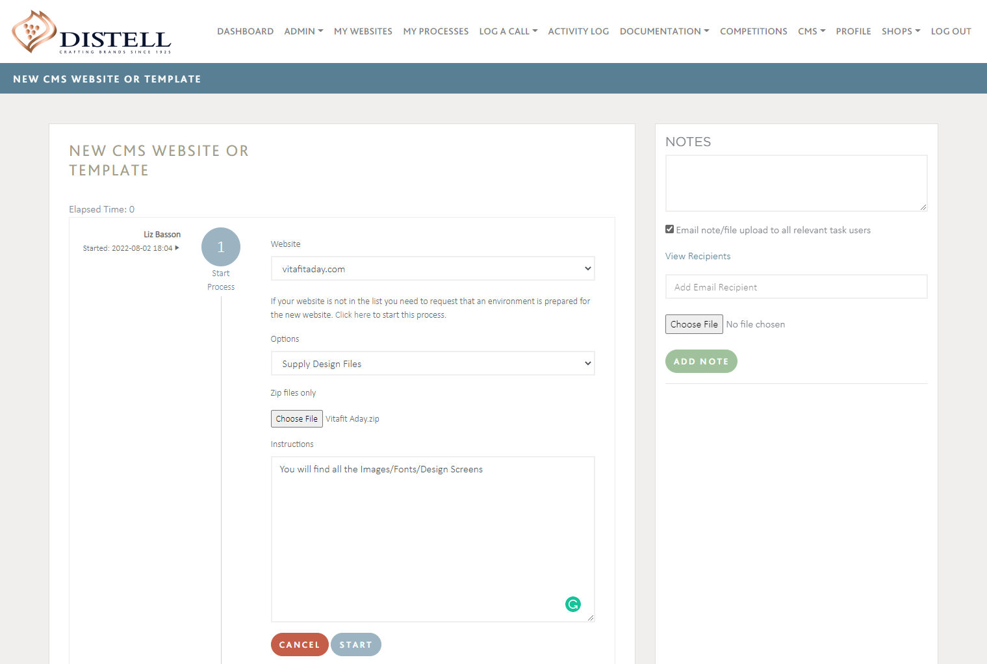
New CMS Website Or Template: Start Process
1
Agency
Login to Distell Web Control https://www.distellwebcontrol.co.za/
On the LOG A CALL Menu item request a NEW CMS WEBSITE
Select the Website
Select one of the following handover methods:
Supply design files
Copy staging website
Supply raw HTML and elements
Upload all files Zipped
Notes:
Web control is our change/ version control solution.

Slide 10
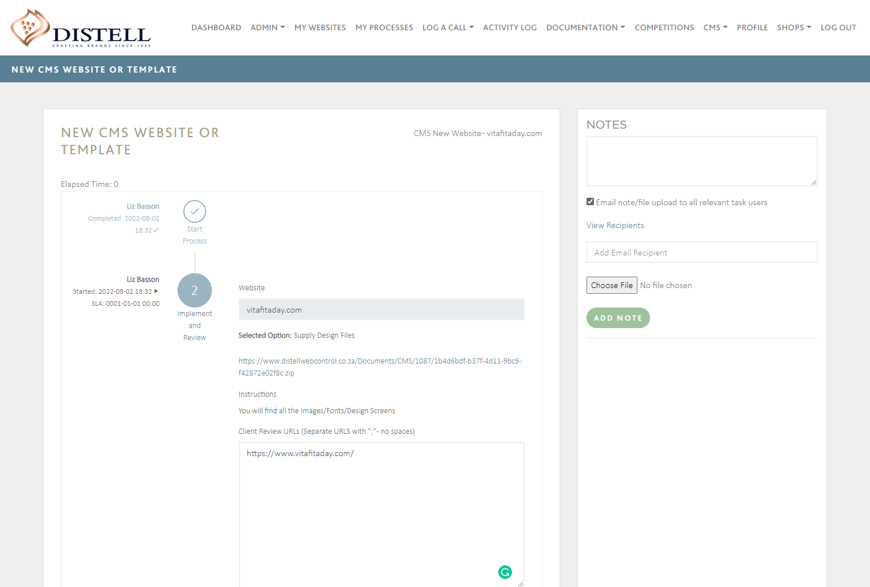
New CMS Website Or Template: Implement and Review
2
Implementation Team
Select Task from dashboard
Extract ZIP file content
Create templates from files
Create pages and content
Paste URLs for review once completed

Slide 11
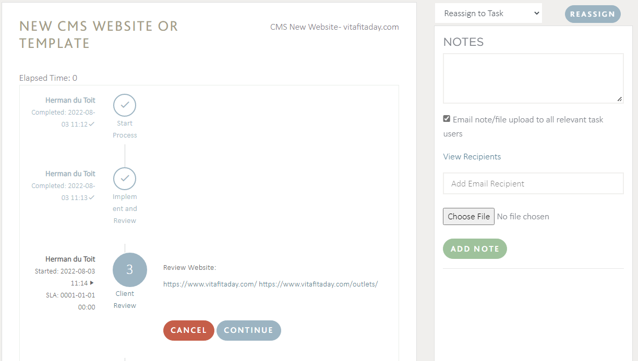
New CMS Website Or Template: Client Review
3
Agency / Client
Click on Links to review pages
Click Continue to approve
OR
Note: Capture notes and re-assign task if not approved – this will send the task back for remediation.

Slide 12
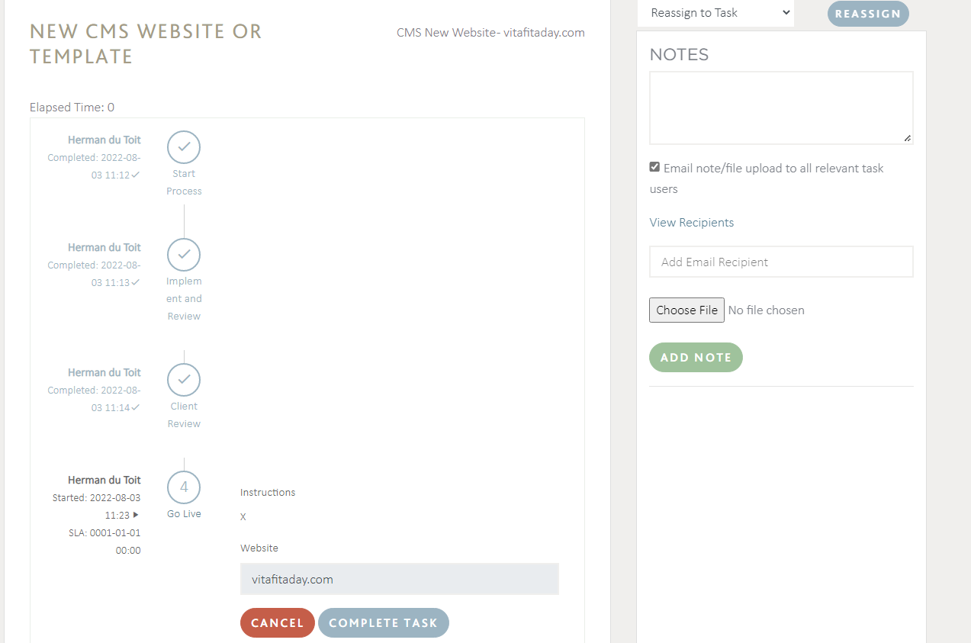
New CMS Website Or Template: Go Live
4
Implementation Team
Follow Agency instructions
Press Continue to put website live
Do post – live checklist

Slide 13

Update CMS Website Or Template

Slide 14
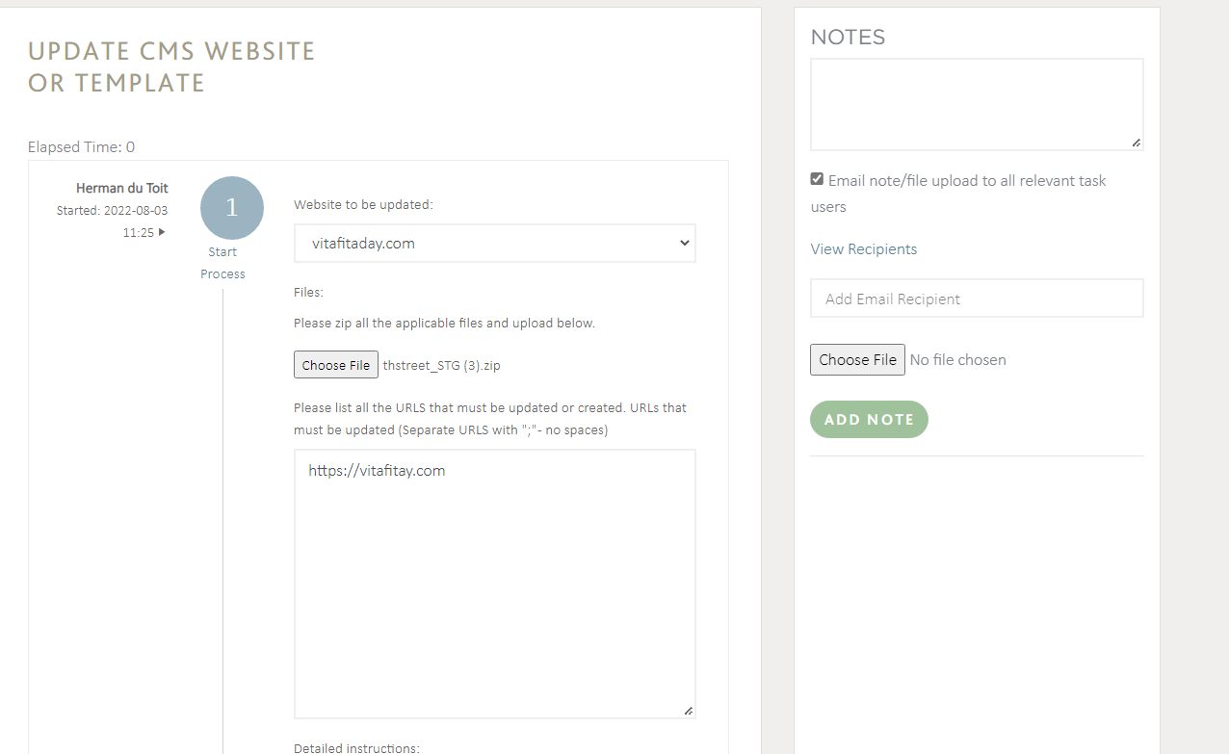
Update CMS Website Or Template: Start Process
1
Agency
Login to Distell web control https://www.distellwebcontrol.co.za/
On the LOG A CALL Menu item request an Update CMS Website
Select the Website
Upload all files Zipped
Supply a list of URLs to be updated
Capture any detailed instructions

Slide 15
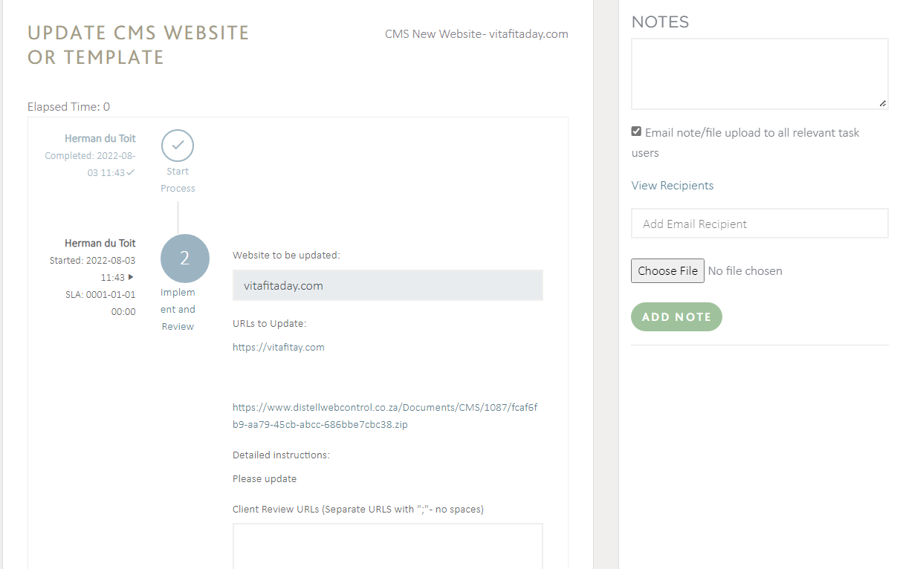
Update CMS Website Or Template: Implement and Review
2
Implementation Team
Select Task from dashboard
Extract ZIP file content
Make changes to content or templates as requested.
Paste URLs for review once completed

Slide 16
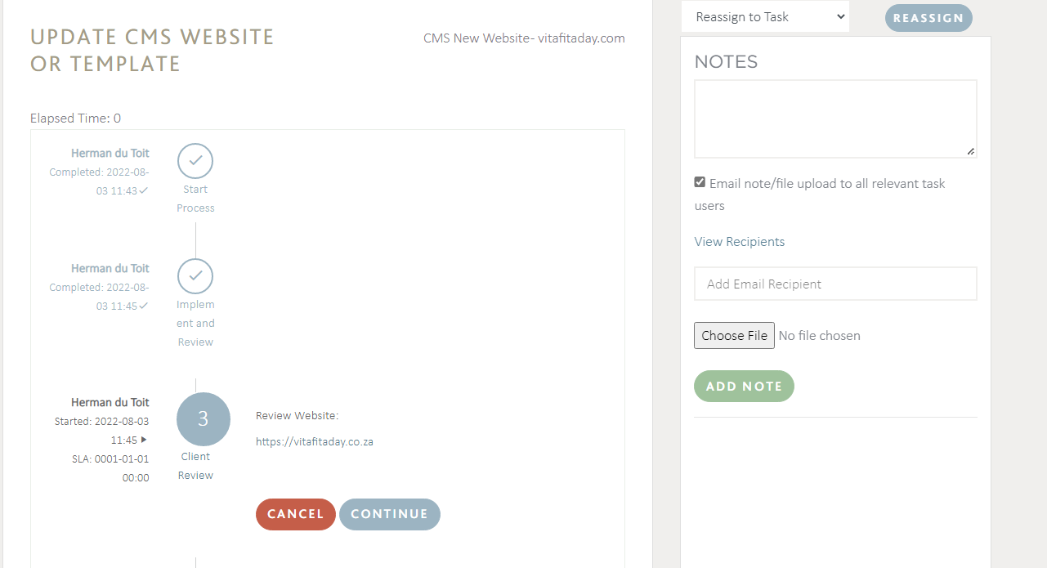
Update CMS Website Or Template: Client Review
3
Agency / Client
Click on Links to review pages
Click Continue to approve
OR
Note: Capture notes and re-assign task if not approved – this will send the task back for remediation.

Slide 17
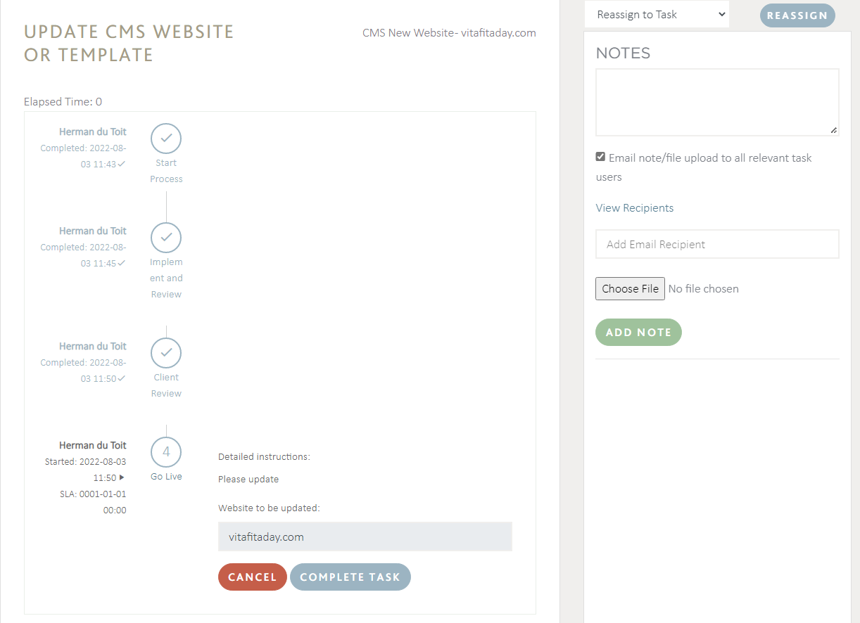
Update CMS Website Or Template: Go Live
4
Implementation Team
Follow Agency Instructions
Press Continue to put changes live
Do post – live checklist

Slide 18


Slide 19
Support
To get support on Distell CMS email:
  herman@partner-us.co.za
  ivan.engelbrecht@distell.co.za
  adedekind@distell.co.za

