Slide 1




Slide 2
An introduction
Notes:
Hello everyone and welcome to our first training session on Bynder.​
​

Slide 3

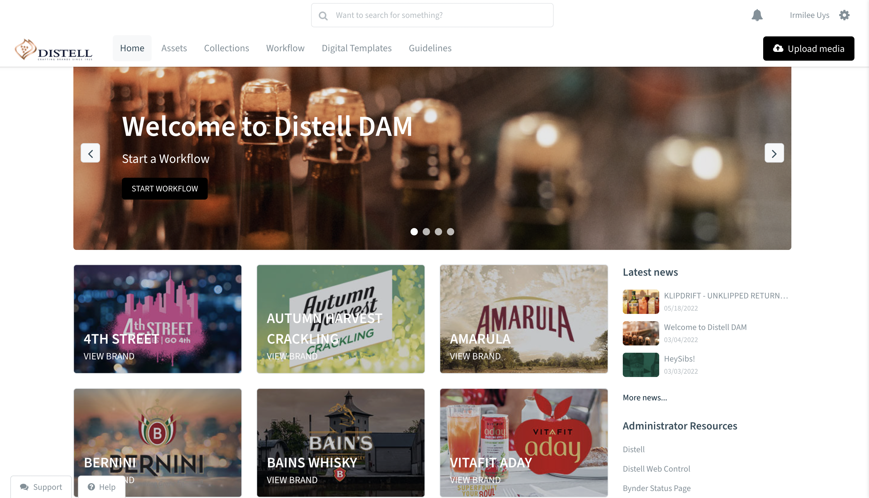
Why were you invited to this session?
You’re now a Bynder user!
Effective 15 July 2022
Brand 360 will be closed mid August
Yes, all your data that was in Brand 360 is now in Bynder
Notes:
Some of you may be wondering: Why am I here? The answer is simple:
You’re now a Bynder user! We’re migrating our digital asset management solution from Brand360 to Bynder
It’s likely that you’re currently a user of Brand360, or you may find that you’re a future user of Bynder
Bynder is a powerful DAM solution and over the course of the next few weeks we’ll be introducing new functionality that’ll streamline the way you work with your creative assets.
You are in this session to get acquainted with Bynder
Please take not of these important dates. (Refer to slide)
And yes, all your data that was in Brand 360 is now in Bynder.

Slide 4
What type of asset user are you
1
Are you a production user, or a consumptive user – or both?​
Production: Create and upload content/assets or play a part in the development process​
Consumptive: Make use of the assets available to use. (Adapt, view, download etc.)​
We have assigned your user authorizations based on your role:​
I’m a brand team user​
I’m a trade marketing team user​
I’m a distributor user​
I’m an agency user​
2
Notes:
You might be wondering – certainly if you’re new to working with our creative assets – what type of user you are?​
What is a production user, and what is a consumptive user? And how is it possible to be both?​
A productive user is someone who generally creates and uploads assets, or plays a part in the process of developing assets.​
A consumptive user is someone who generally uses the assets available to them, maybe adapts them but doesn’t create assets or upload any.​
And why is this important to know?​
We know that the role you play in the business or as an external partner tends to define the way you use Bynder, and we’ve established user authorisations and available functionality on the premise of your role.​
If you find that you need access to additional features or functionality in the future – contact our system administrator to update your system permissions.​

Slide 5
Our approach in the design of Distell’s Bynder application:
1
Simple & easy to use
2
Intuitive and user-centred
3
Designed for busy people
4
Single source of truth
Notes:
We haven’t upgraded our DAM since 2011, and we want to say we heard many of your Brand 360 related frustrations in the past.​
We were super dedicated to ensuring that Bynder is: Simple and easy to use. It needs to feel like it’s adding value to you from the get go.​
We designed Bynder around the user-YOU- and our understanding of our Distell marketing practice. ​
We know you’re all super busy and have lots of priorities to juggle and we also understand that Bynder is but one of many different tools and applications that Marketers and their working partners work with on a daily basis. ​
Single source of truth – as you’ll see – Bynder is a super powerful tool and should be treated as the single point of place for all your go –to assets like logo’s, packshots, brand guidelines. No more guessing if you have the latest version. No more downloading and saving onto your desktop. No more emailing to all and sundry. Treat Bynder as the single place to keep up to date for everyone to access. You’ll see just how easy it is to do this in our training session, and how easy it is to share with your working partners and other stakeholders. ​
​

Slide 6
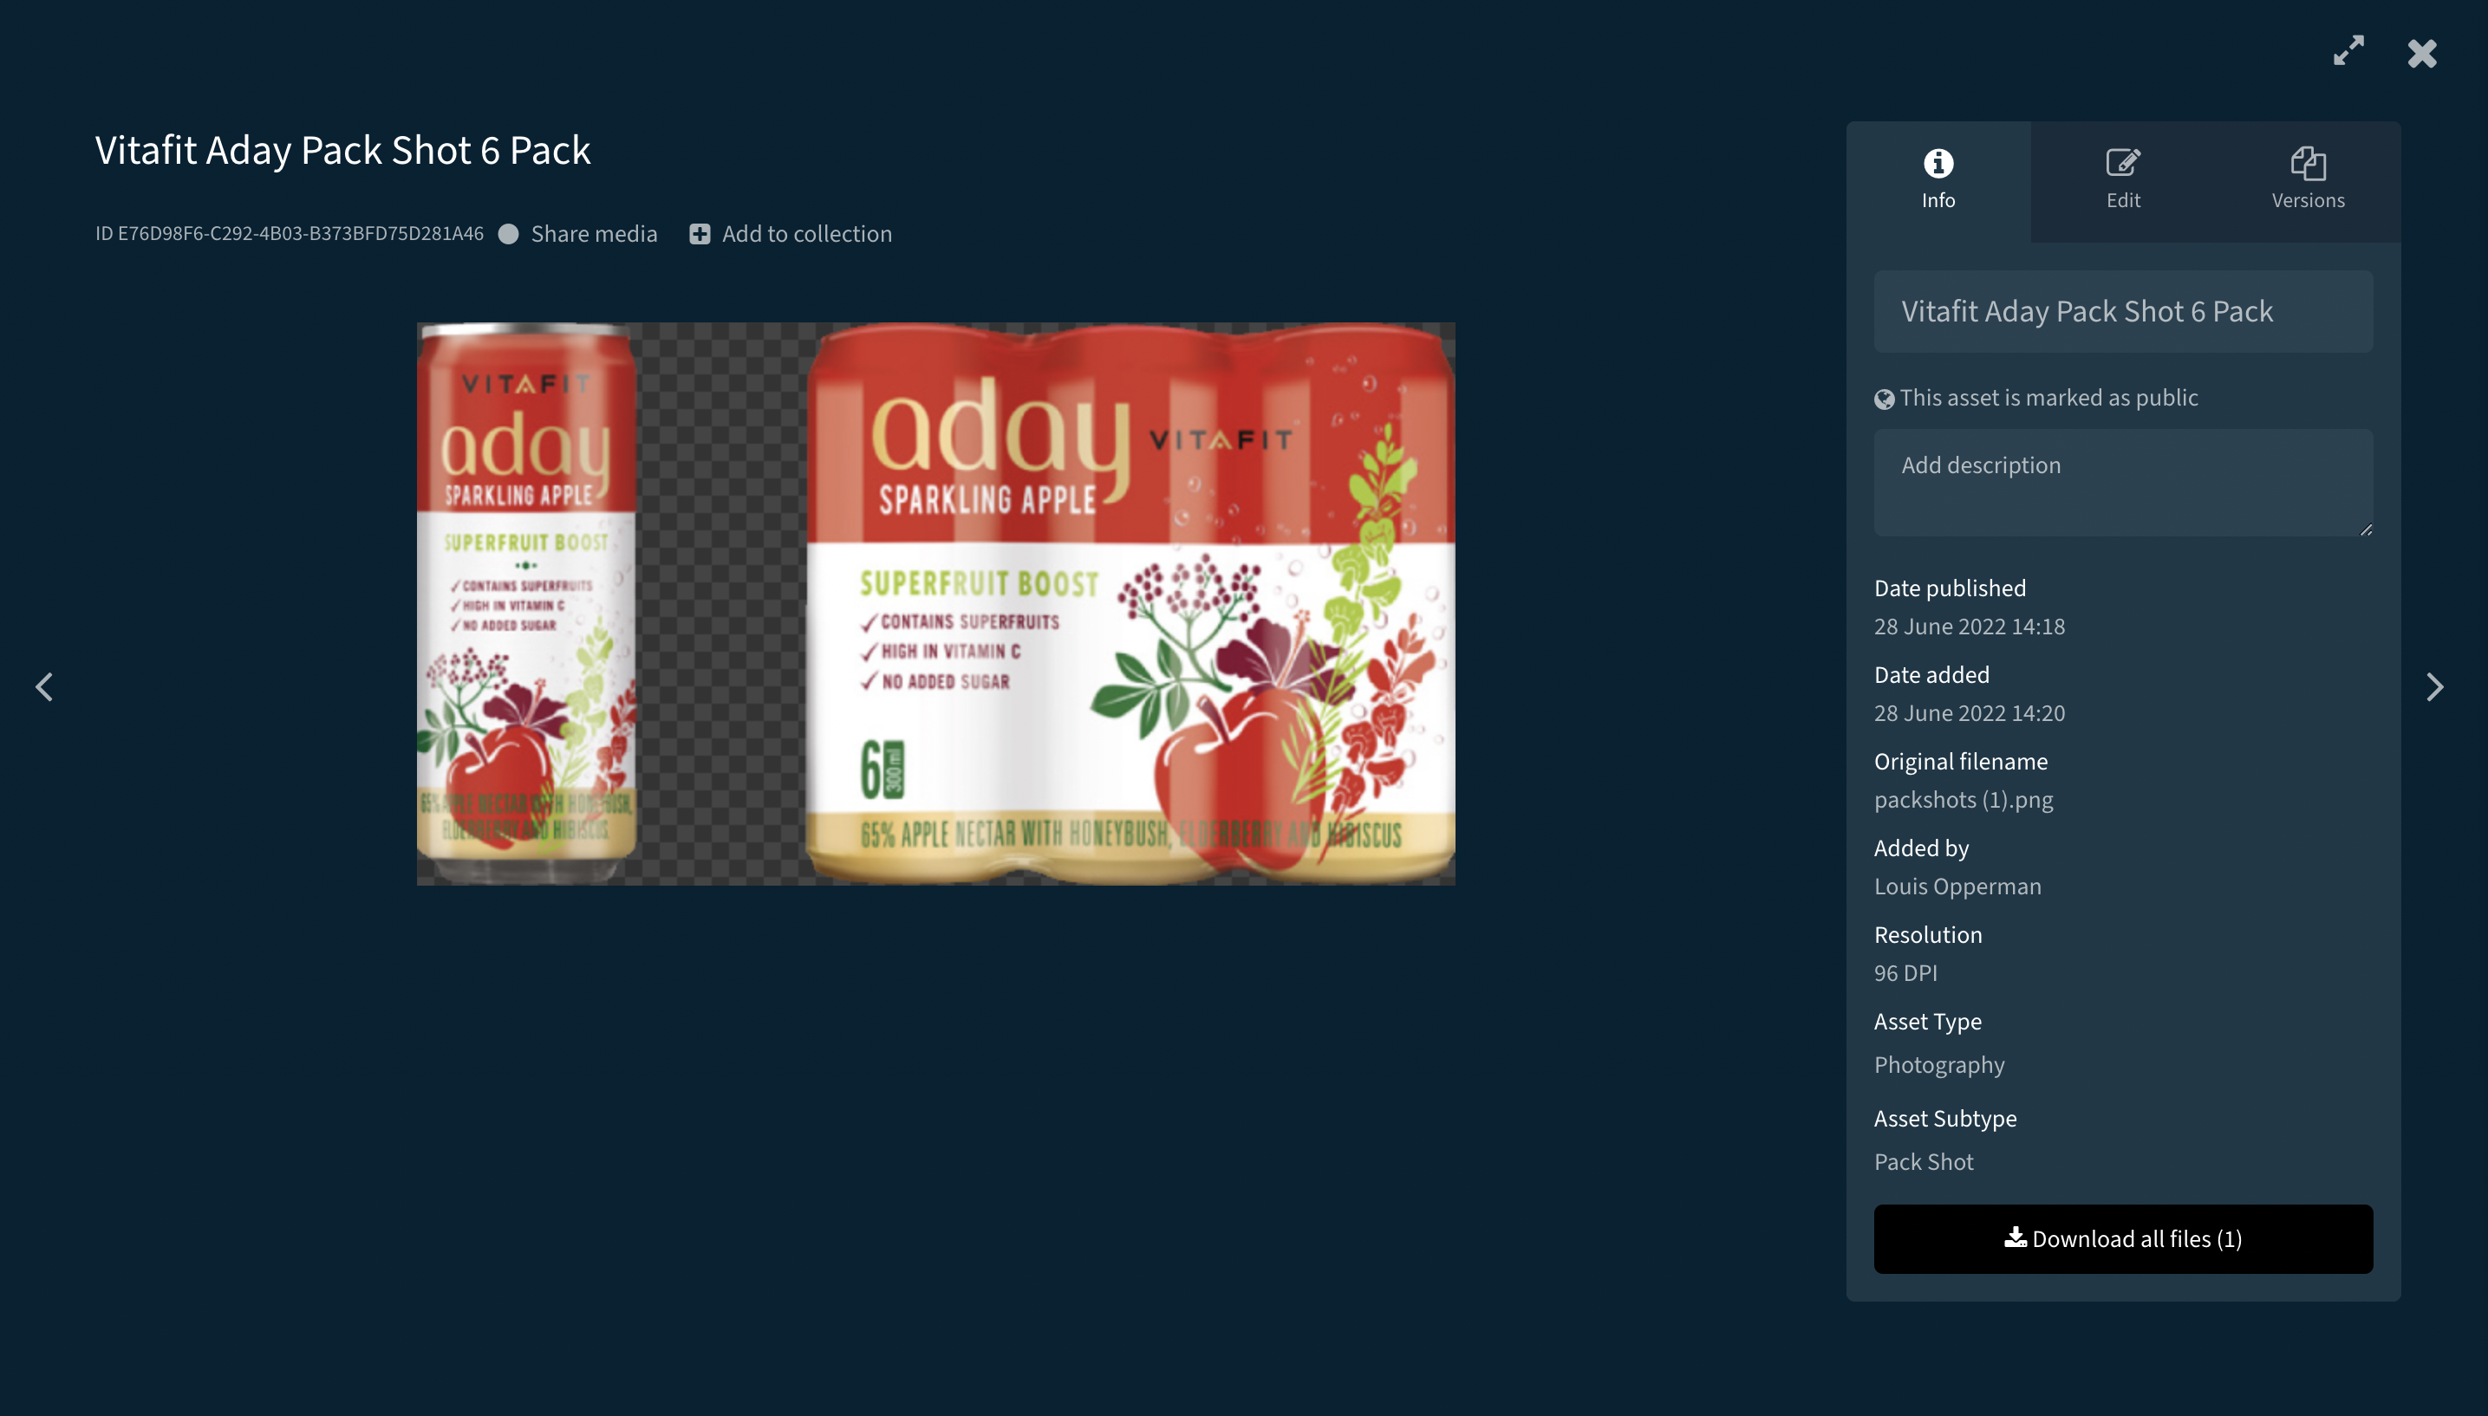
A brief functionality overview: Assets
This is the section you’ve used in Brand 360 the most
We’ll be introducing you to a new taxonomy.
Notes:
And here comes a quick ‘highlights’ tour of everything Bynder has to offer.​
Assets. This is where you store assets, search for them, share them with others and add them to ‘collections’ (which is like a smart folder).​
This is probably the closest to how you’ve used Brand 360.​
We’ve also introduced a more intuitive taxonomy and a specialized role to assist with the upload of assets – making sure assets are assigned with the right taxonomy from the get go = this is going to make finding your assets and the search function even easier.​

Slide 7
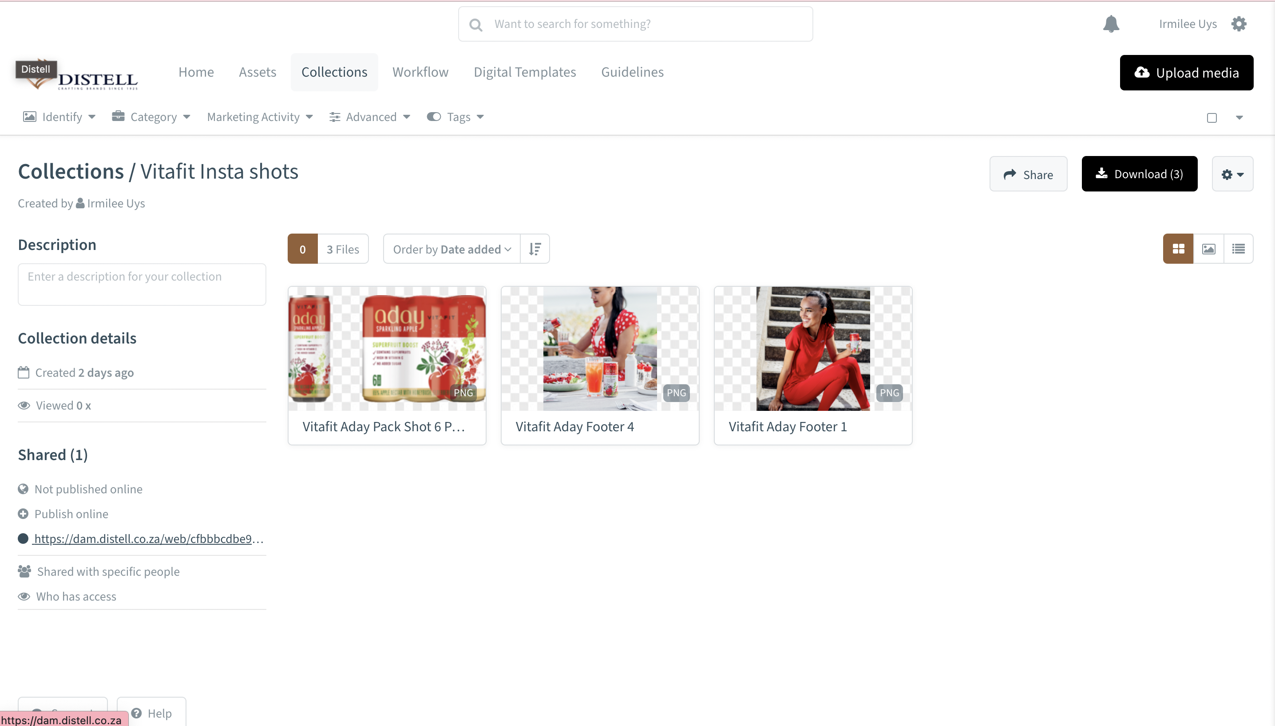
A brief functionality overview: Collections
These are campaigns, which allow a user to create collections of assets that relate to each other
Example: Father’s Day
Notes:
We like to think of a collection as a ‘smart folder’ or a campaign folder, or in it’s simplest terms – a grouping of assets that you’ve grouped together for a specific reason.​
Examples could be: Easter promo campaign. So the collection in this instance is all the assets associated with that campaign.​
Or, a collection of assets that you’ve made to assist with briefing a new creative partner ie: take a look at what we’ve done before, or how we’ve treated the creative before etc.​
Or, all the elements you need to create a complete listing on the digital shelf.​
I’m sure you can think of more.​
​

Slide 8
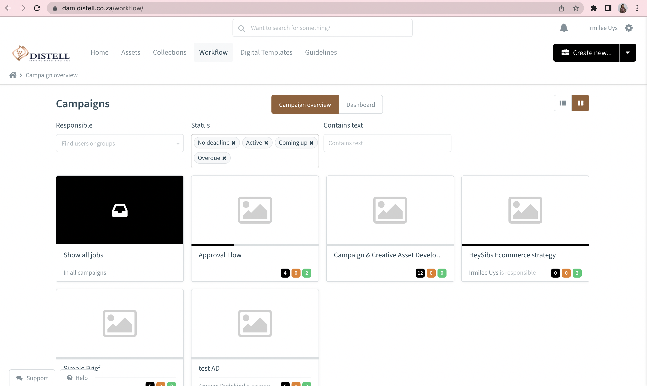
A brief functionality overview: Workflow
This is new functionality
It is your future ‘workbench’ for creating assets with your creative partners & brand teams
From sending the brief, to annotating for reverts, to approvals, this is where the magic happens going forward
Notes:
Bynder offers a powerful workflow engine – and allows for a limitless number of different types of workflows. ​
We’re going to start with a simple approach, and this is new for everyone. ​
This is the future workbench where you’ll work with creative partners to develop creative assets. From initiating the brief, annotating your feedback on the creative – yes on pdf documents and video’s too.​
Culminating in the necessary approvals and the final upload of the open artwork files.​
We’re starting with 2 workflows: one for a simple brief (singular output), and one for a more complex campaign involving multiple touch points. We designed these with some of our agency partners, and we think this is a good place to start.​
We’re looking forward to your feedback and to designing more workflows for you – prizes for the first person to use the suggestion box!​

Slide 9
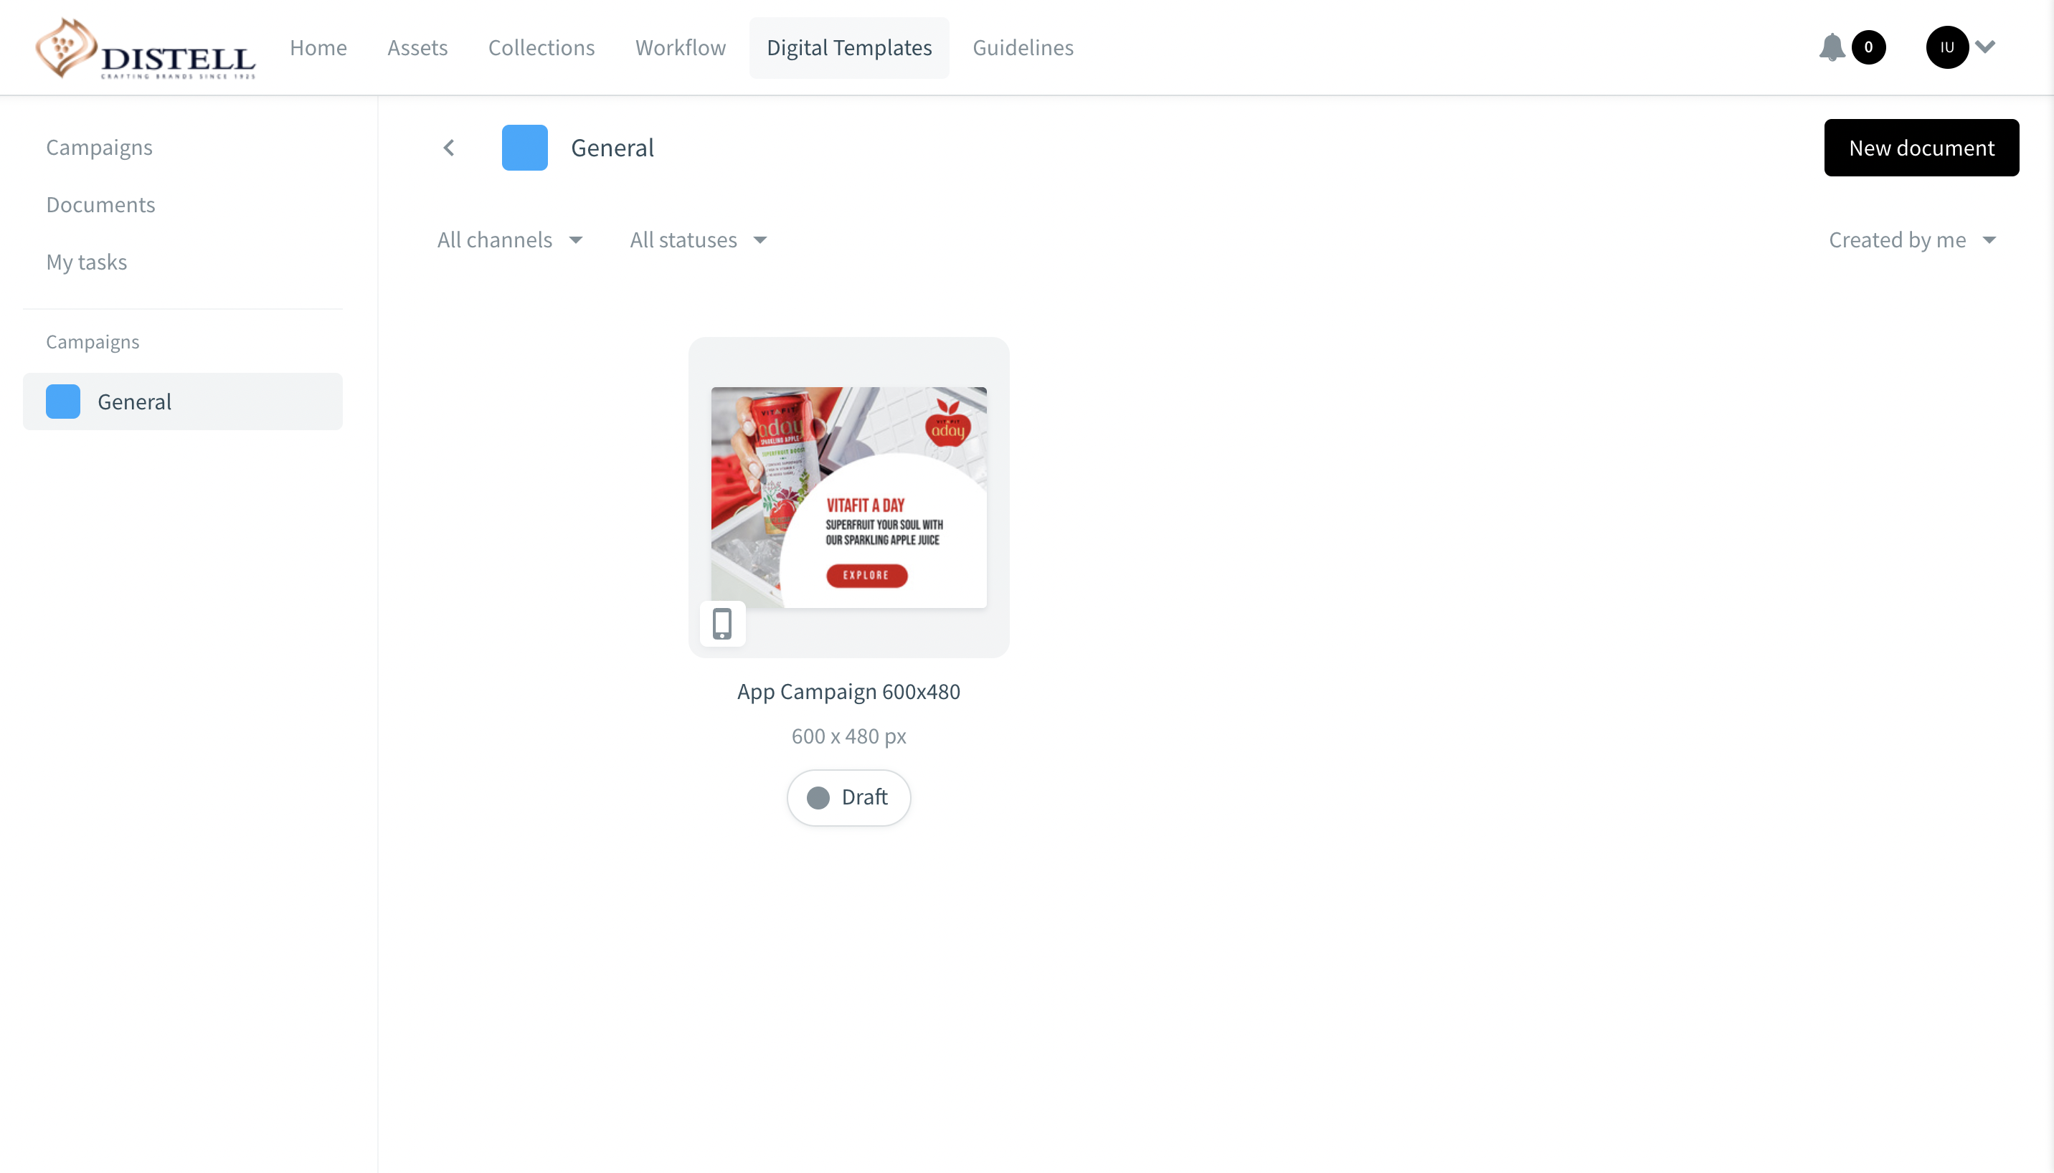
A brief functionality overview: Digital Templates
This is also a new feature!
You’ll be able to create digital templates which your ‘in country’ colleagues or other agency partners can adapt and use for digital channels
It’s going to make life easier, faster and seamless for all
Notes:
Digital templates are also a new feature.​
Think of those digital touchpoints that you use a lot, produce the templates here in Bynder and adapt/ resize in Bynder.​
Here are some ideas:​
Social posts that lend themselves to templates ie: Winner announcements, Listing announcements.​
Web/ advertising banners​
Fact sheets​
Creating templates that end market users can use: change copy / translate into local languages. Update to the local pack etc.​
The options here are limitless. Give some thought to how this feature can make life easier, faster, simpler AND save on costs.​

Slide 10
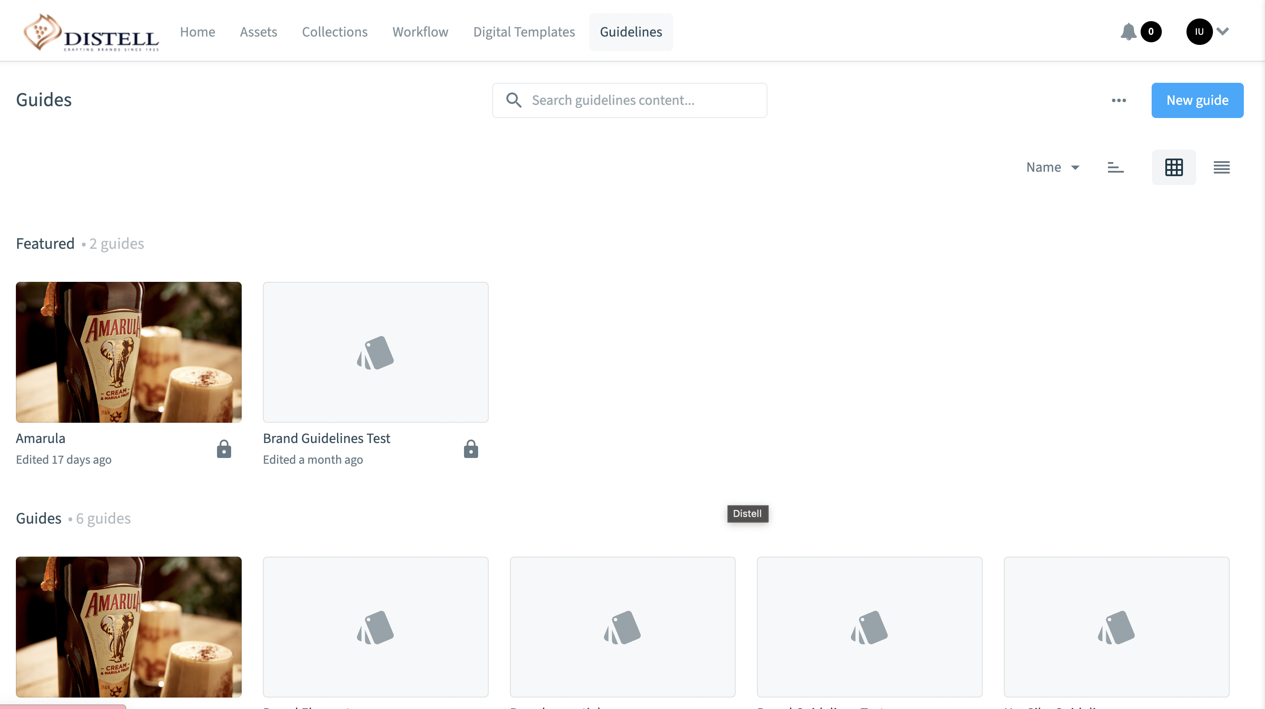
A brief functionality overview: Brand Guidelines
This should become the single source for your brand guidelines in the future – easily accessible to anyone via a link.
Notes:
In Bynder Brand guidelines are a section in their own right and consist of webforms which you will design in Bynder. (Don’t worry – you’ll get trained on this at the right time)​
We all know the importance of brand guidelines and we agree, finding the latest copy on your desktop and emailing it to all and sundry is a bit of a chore.​
Imagine all you need to do now is send someone a link to view them – they don’t even have to be a Bynder user! ​
No more downloading, emailing, worrying if you have the latest version. Just keep the Bynder guidelines section up to date as your master – and hey presto – everyone else will be up to date too.​

Slide 11
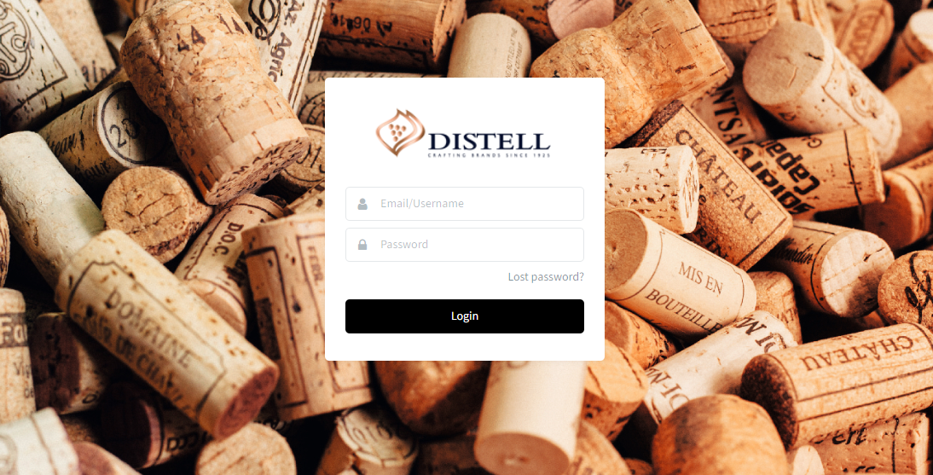
Let’s get started on the Bynder Adventure
  Log into Bynder
  Access the page where you log in to your Bynder portal
  https://dam.distell.co.za/
  Check:
  Do you have access to the right brands?
  Do you have access to the right features you need?
  Need help? We’ve designed a support portal too.
Notes:
You should all have your logins by now, and the correct permissions by brand.​
If this is not the case, contact your administrator and we can help get you up and running.​
We’ve also introduced a support portal where you can access all the help you need to get started.​

Slide 12
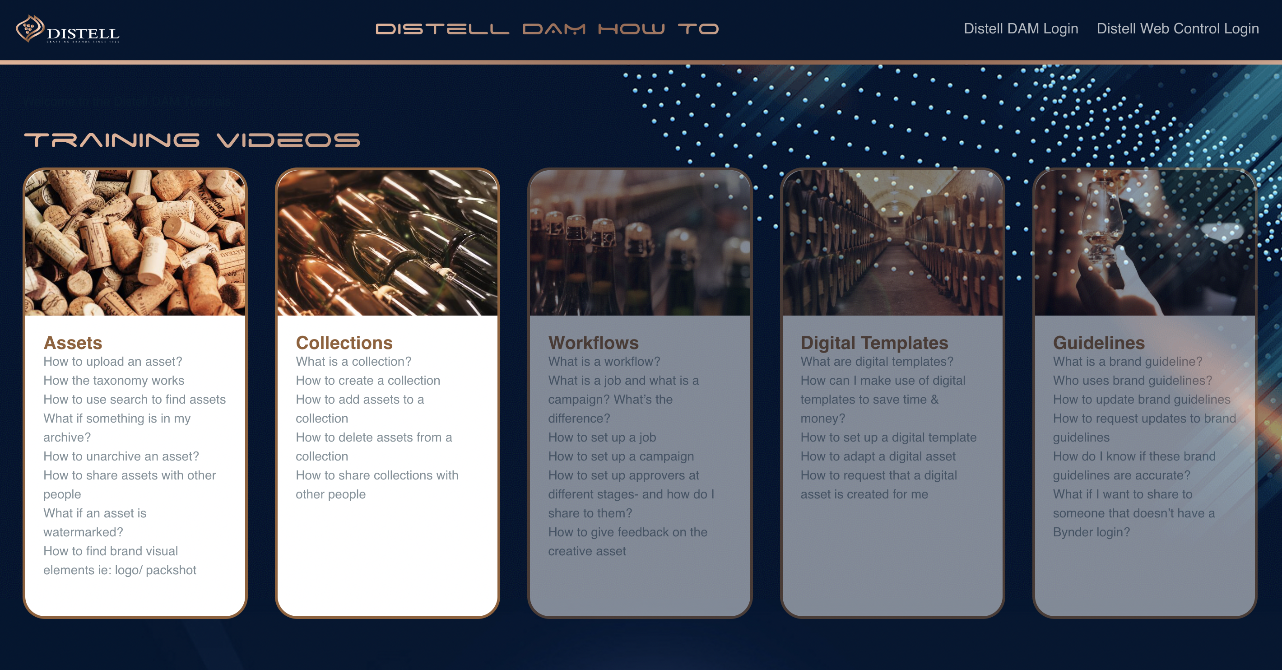
All the ways you can get support on Bynder
  Support URL: https://www.distellwebcontrol.co.za/BynderHowTo
  Send an email to:
ivan.engelbrecht@distell.co.za
Notes:
You’ll never be alone on Bynder.​
We’ve designed a number of different support mechanisms to assist you to get the most out of Bynder.​
​

